Slide 1
From Chat Boxes to Chatter Boxes: Get them to talk!
Minnesota Summit on Learning & Technology
August 1, 2019
Anastasia Martin
Social Studies Teacher
Minnesota Online High School
Notes:
Quizlet
VoiceThread pages
Welcome! I’m Anastasia Martin from Minnesota Online High School. Or MNOHS as we affectionately call it.
I’ve been teaching at MNOHS since the Fall of 2005.

Slide 2
About MNOHS…
Fully online
Statewide charter school
Working with comprehensive (“full-time”) and supplemental students
Mainly asynchronous with lots of synchronous support
Teacher and student-led
Creative and connected!
Notes:
Some of you know MNOHS or ‘minnows’ (as we call ourselves) and probably some of you have never hear of us or mix us up with some other online high schools in the state. There are about 30 online programs for MN high school students.
How many of you are fully online?
Blended?
Classroom-based?
We are a fully online charter school serving students state-wide and even a couple tuition-paying out-of-state students. We have students who are both comprehensive (full time) and supplemental. Most of our interactions with students are asynchronous BUT we offer many synchronous supports….and you will see examples of the ways my colleagues and I create presence in this setting. MNOHS is teacher and student-led which makes for a unique model in online education – we just celebrated our 10th school year and most of the teachers on staff were here when we started, including myself. And we are always looking for new ideas to be creative in our classrooms and connected to students and the greater MNOHS community.
So, that brings me to why I’m here today! To share some of what I have learned in the last 14 years of teaching (and learning!) in a fully online setting. Throughout the next two days I hope to also learn from you and others who might be presenting.

Slide 3
Objectives
Learn strategies to engage students in the online classroom
Discuss the benefits of voice participation in the online classroom
Develop scaffolding strategies that lead to increased student participation by voice
Notes:
Getting students to talk by voice in an online classroom is a challenge. The default setting for modern communication is text and, yet, we become frustrated when students don't want to use their voice to speak in our classrooms. We have to be intentional about teaching them to talk. What I want to share is one way I have found success.

Slide 4
Tools I Use
VoiceThread
Notes:
The scaffolding begins on Day 1 in my classroom. At MNOHS we use a tool called VoiceThread.
These are some of the tools I use – not all – but you will hear me talk about these many times today.
Poll to see who is familiar with each of these.
How many of you have used or heard of VoiceThread?
VoiceThread is a web-based collaboration and sharing tool that allows the users to add images, documents, and videos, and then add their own comments by audio, text or video. Then other users can view these VTs and add additional comments by audio, text, or video.
Your Learning Management System might have a built-in voice authoring tool – wimba? ‘
What tools do you use?
VT pricing for individuals
K-12 $79/year or $15/month
Higher Ed $99/year

Slide 5
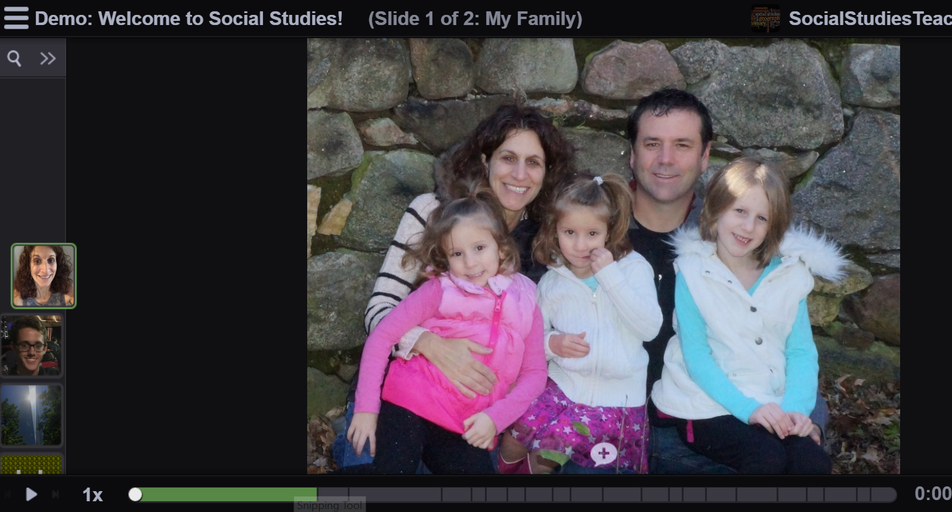
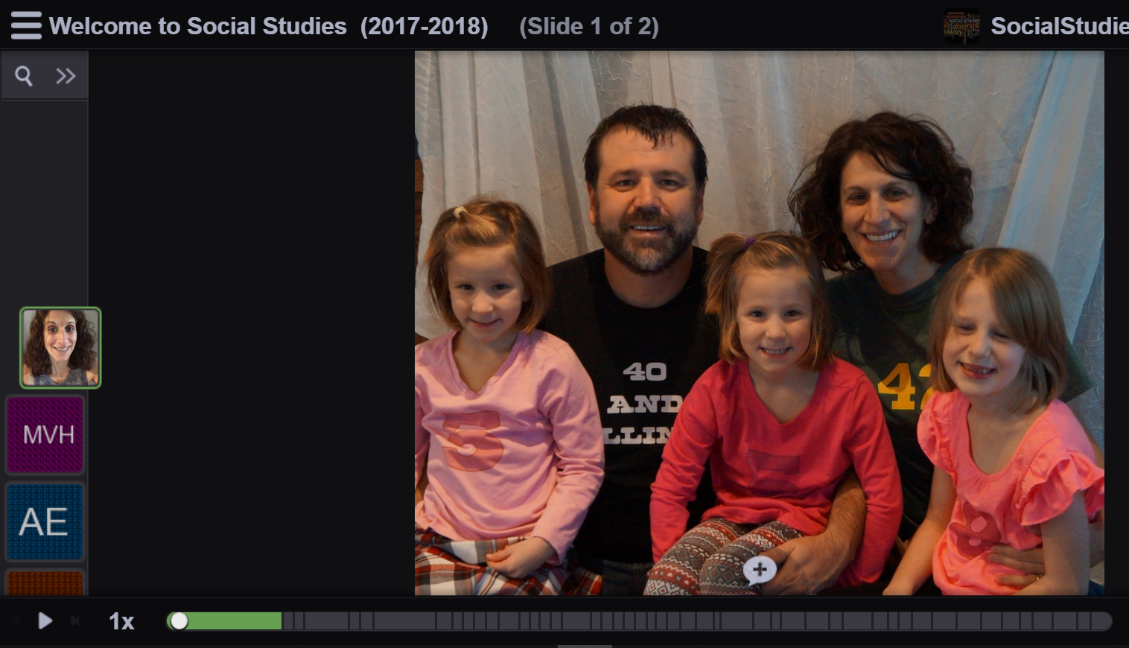
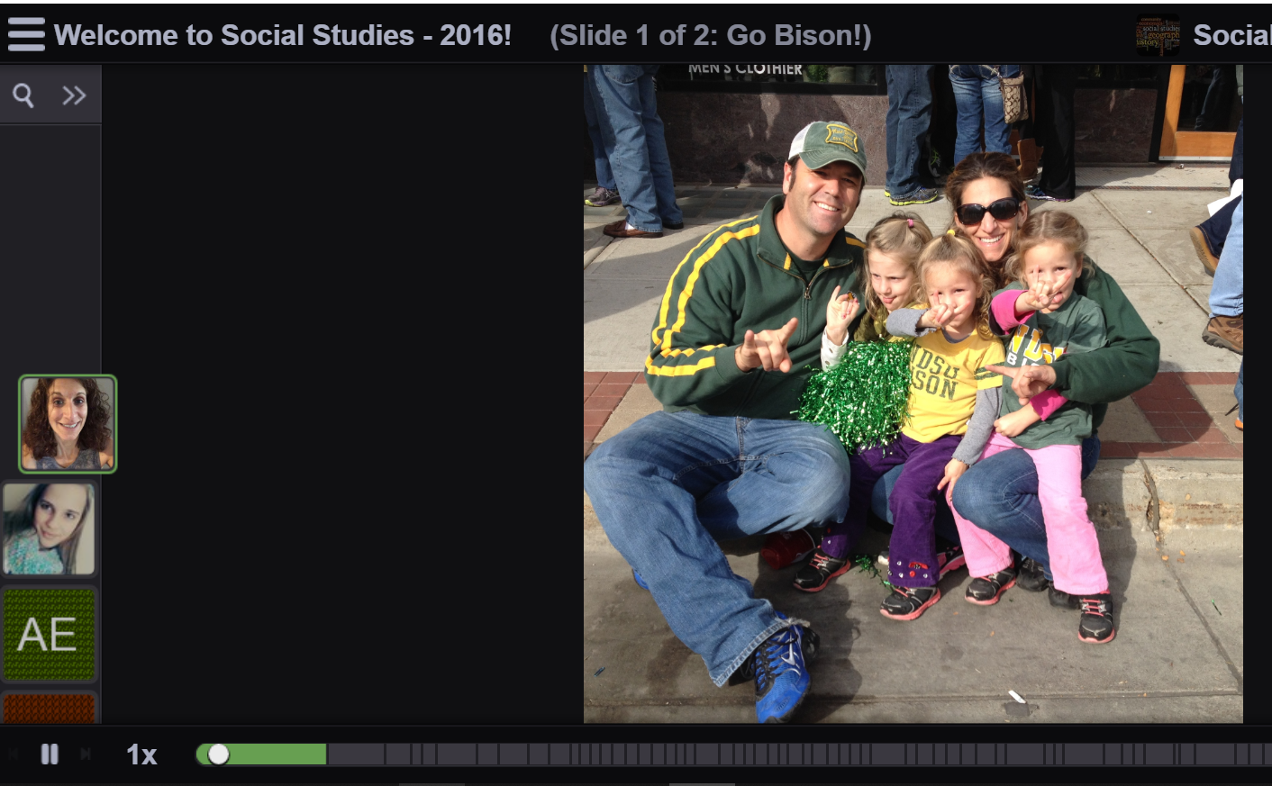
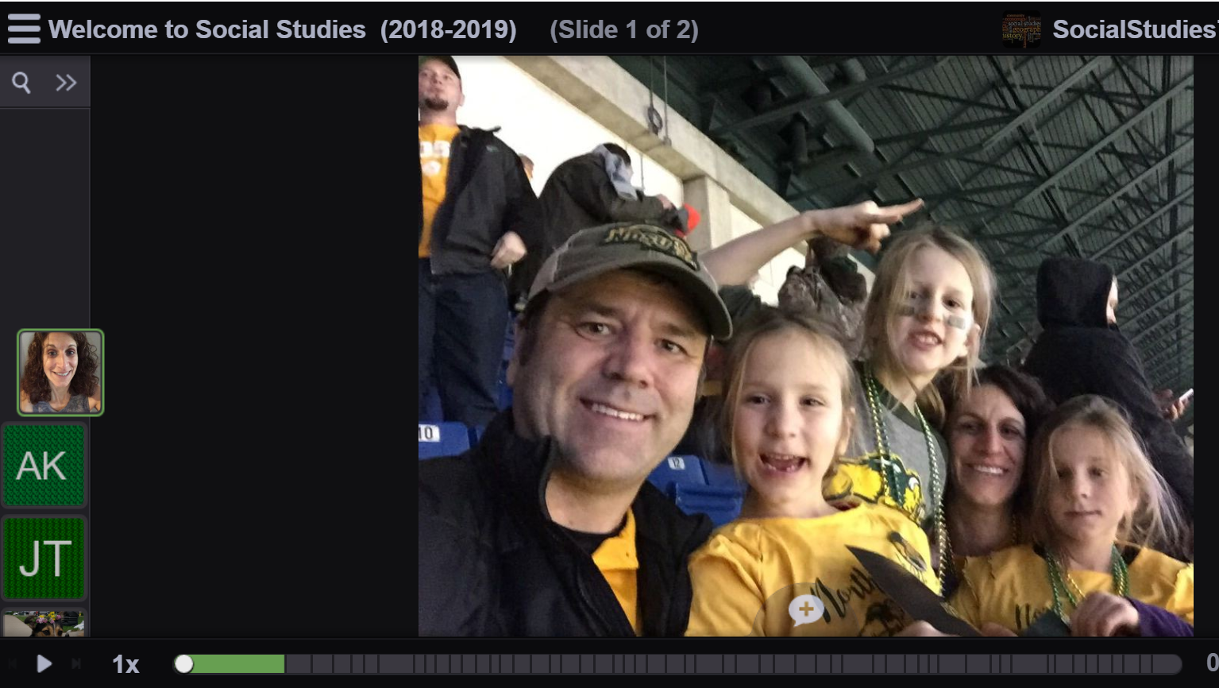
Day 1
Notes:
The scaffolding begins on Day 1 in my classroom (but, of course, my students don’t actually know this!). I post a welcome VoiceThread (combination of image and audio – using whatever tool you want to use)
Step 1: Share Welcome VT: https://voicethread.com/share/12780686/
I post by voice
Students can post by text or voice – they choose
This kind of participation is non-threatening. They are sharing information that they already know – their name, why they chose MNOHS and something they like to do in the summer. If you are in physical classroom on Day 1, voice is automatically required. BUT you could have students first share this information with an elbow partner and then introduce their partner to the larger group.
They are ALSO learning how to use the technology if it is new to them.

Slide 6
Week 1
Synchronous class meeting (webinar)
Discussion - written
Notes:
In the first week of class, students will also participate in a webinar (synchronous) class meeting OR a VoiceThread make-up session (https://voicethread.com/share/8163339/). Both start with an icebreaker each week - Week 1 is the Story of Your Name (another non-threatening post)
In the synchronous meeting, I let students mostly use the chat. In VoiceThread, I ask them to use their voice. I use my webcam so they can see me and recognize that I’m a person. I also use my webcam in VoiceThread.
The first discussion is also non-threatening --- not based on any specific content knowledge, but related to the Week 1 content which is about human origins and how early humans adapted to their environment as a means of survival.

Slide 7
Basic Structure
Vocabulary
Context (teacher)
Initial Thoughts
Background
Graphic Organizer/Notes
Discussion question (with prompts)
Respond to classmate (with prompts)
(Final thoughts)

Slide 8
Week 2
Vocabulary (student)
Context (teacher)
Vote (initial opinion) (student)
Read/Watch background information with Graphic Organizer (student)
Use notes to post in discussion & reply (student)
Write reasons to support (new) opinion (student)
Notes:
Week 2 is the first week that students will be required to actively post by voice in a VoiceThread. (https://voicethread.com/share/9581964/)
Padlet: https://padlet.com/MrsMartinMNOHS/FarmingForaging

Slide 9
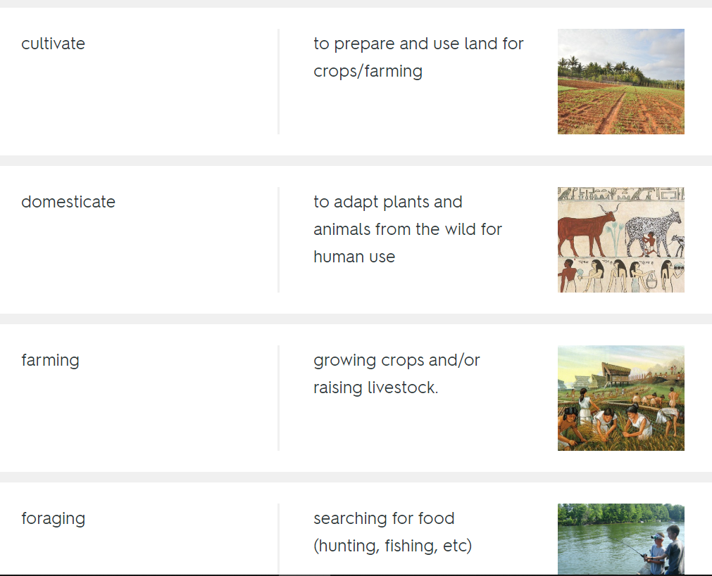
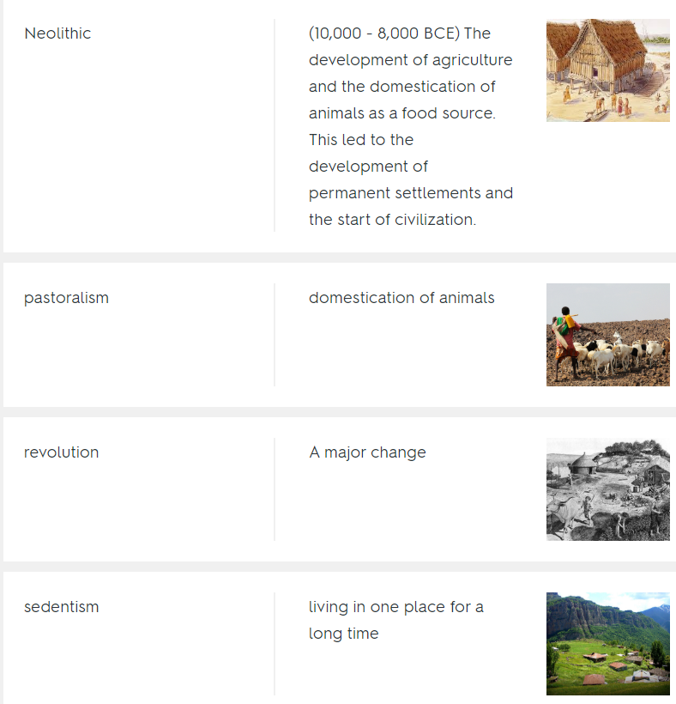
Vocabulary

Slide 10
Week 2
Vocabulary (student)
Context (teacher)
Vote (initial opinion) (student)
Read/Watch background information with Graphic Organizer (student)
Use notes to post in discussion & reply (student)
Write reasons to support (new) opinion (student)
Notes:
Week 2 is the first week that students will be required to actively post by voice in a VoiceThread. (https://voicethread.com/share/9581964/)
Padlet: https://padlet.com/MrsMartinMNOHS/FarmingForaging

Slide 11
Week 2
Vocabulary (student)
Context (teacher)
Vote (initial opinion) (student)
Read/Watch background information with Graphic Organizer (student)
Use notes to post in discussion & reply (student)
Write reasons to support (new) opinion (student)
Notes:
Week 2 is the first week that students will be required to actively post by voice in a VoiceThread. (https://voicethread.com/share/9581964/)
Padlet: https://padlet.com/MrsMartinMNOHS/FarmingForaging

Slide 13
Week 2
Vocabulary (student)
Context (teacher)
Vote (initial opinion) (student)
Read/Watch background information with Graphic Organizer (student)
Use notes to post in discussion & reply (student)
Write reasons to support (new) opinion (student)
Notes:
Week 2 is the first week that students will be required to actively post by voice in a VoiceThread. (https://voicethread.com/share/9581964/)
Padlet: https://padlet.com/MrsMartinMNOHS/FarmingForaging

Slide 14
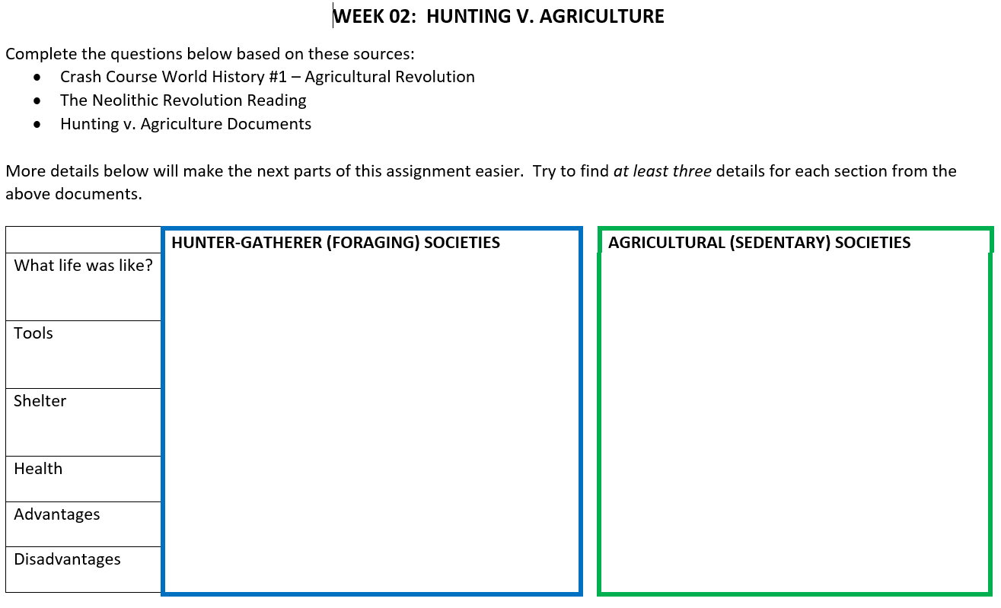
Graphic Organizer

Slide 15
Week 2
Vocabulary (student)
Context (teacher)
Vote (initial opinion) (student)
Read/Watch background information with Graphic Organizer (student)
Use notes to post in discussion & reply (student)
Write reasons to support (new) opinion (student)
Notes:
Week 2 is the first week that students will be required to actively post by voice in a VoiceThread. (https://voicethread.com/share/9581964/)
Padlet: https://padlet.com/MrsMartinMNOHS/FarmingForaging

Slide 16
Discussion:
Was FARMING an improvement over FORAGING?
Think about:
What is the difference in lifestyle?
How is the health of each group?
Are the tools or shelter improved?
What are the advantages or disadvantages that need to be considered?
Notes:
Now you will show your thinking by sharing your position about the degree to which life in agrarian societies was better or worse than life in foraging societies.
Think about:
Use evidence from the readings/documents to support your view – give at least 2 specific examples.
You should include your first impressions about the quality of life among agrarian and foraging societies, the key elements of the evidence provided, an opposing viewpoint, and reasons for your conclusions. You should use and cite information from the texts to support your argument and to acknowledge the opposing point of view.

Slide 17
Listen to what your classmates have posted.
Return to post at least one thoughtful response to a classmate.
What is a “thoughtful response”?
A question, comment or wondering that adds to the discussion.
“What do you think about….?”
“I wonder if …”
“I disagree/agree with you…and here’s evidence why…”
“Can you tell me more about…”

Slide 18
Week 2
Vocabulary (student)
Context (teacher)
Vote (initial opinion) (student)
Read/Watch background information with Graphic Organizer (student)
Use notes to post in discussion & reply (student)
Write reasons to support (new) opinion (student)
Notes:
Week 2 is the first week that students will be required to actively post by voice in a VoiceThread. (https://voicethread.com/share/9581964/)
Padlet: https://padlet.com/MrsMartinMNOHS/FarmingForaging

Slide 20
Basic Structure
Vocabulary
Context (teacher)
Initial Thoughts
Background
Graphic Organizer/Notes
Discussion question (with prompts)
Respond to classmate (with prompts)
(Final thoughts)

Slide 21
Model United Nations Conference
Week 1 | United Nations Vocabulary & What is the United Nations?
Week 2 | United Nations in the news
Week 3 - 4 | Source credibility & Country Research
Week 5 | Topic Research – Your Country & Climate Change
Week 6 | Position Paper Draft
Week 8 | Final Position Paper Due
Week 9 - 10 | Needs, Positions & Win-Win Solutions
Week 11 | Write example Resolution (based on social scenario)
Week 12 | Write Climate Change Resolution
Week 13 | Persuasive Speech (Listen, feedback, 30 second speech)
Week 14 | Model UN Debate – Session 1
Week 15 | Model UN Caucus
Week 16 | Model UN Debate – Session 2
Notes:
The reason I started to be intentional about teaching students how to talk early in the year was because I wanted to try doing a Model UN Conference at the end of the year.
Previously I had students doing research projects and a VoiceThread presentation at the end of each quarter. And I learned that without heavily using the tool (VoiceThread) and practicing speaking, students would either skip the project or the quality was meh. (Of course there were exceptions – there is a select group of students who doesn’t really need all this scaffolding, but it certainly doesn’t hurt them to do it)
So at the same time that students are doing class Voice discussions for their weekly assignments, they are scaffolding to prepare to participate in the Model UN Conference.

Slide 22
Model United Nations Conference
Week 1 | United Nations Vocabulary & What is the United Nations?
Week 2 | United Nations in the news (Context)
Week 3 - 4 | Source credibility & Country Research
Week 5 | Topic Research – Your Country & Climate Change
Week 6 | Position Paper Draft (Initial thoughts)
Week 8 | Final Position Paper (“Notes”)
Week 9 - 10 | Needs, Positions & Win-Win Solutions (Background – UN process)
Week 11 | Write example Resolution (based on social scenario)
Week 12 | Write Climate Change Resolution
Week 13 | Persuasive Speech (Listen, feedback, 30 second speech)**
Week 14 | Model UN Debate – Session 1 (Discussion)
Week 15 | Model UN Caucus (Respond to classmate – written)
Week 16 | Model UN Debate – Session 2 (Discussion)
(Background & Notes)
(“Notes”)
Notes:
The reason I started to be intentional about teaching students how to talk early in the year was because I wanted to try doing a Model UN Conference at the end of the year.
Previously I had students doing research projects and a VoiceThread presentation at the end of each quarter. And I learned that without heavily using the tool (VoiceThread) and practicing speaking, students would either skip the project or the quality was meh. (Of course there were exceptions – there is a select group of students who doesn’t really need all this scaffolding, but it certainly doesn’t hurt them to do it)
So at the same time that students are doing class Voice discussions for their weekly assignments, they are scaffolding to prepare to participate in the Model UN Conference.
Model UN VT

Slide 23
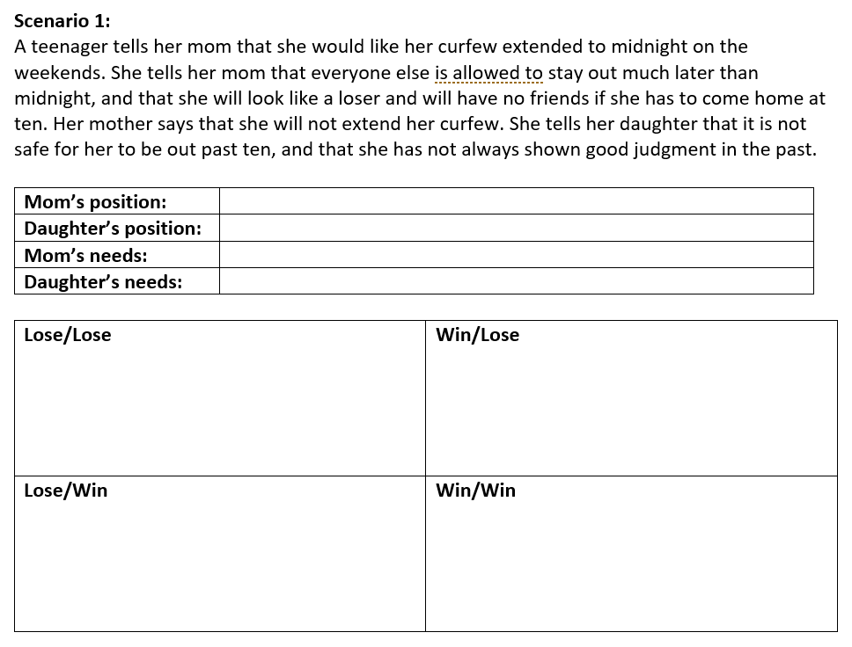
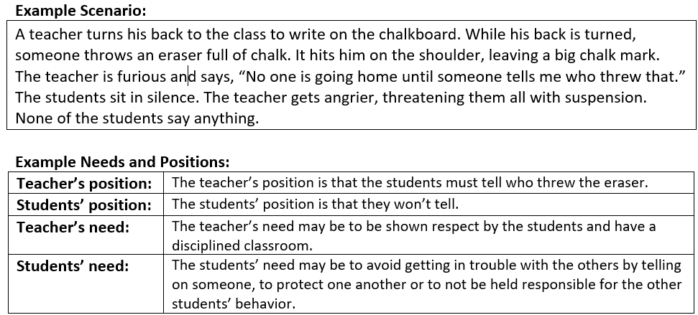

Slide 24
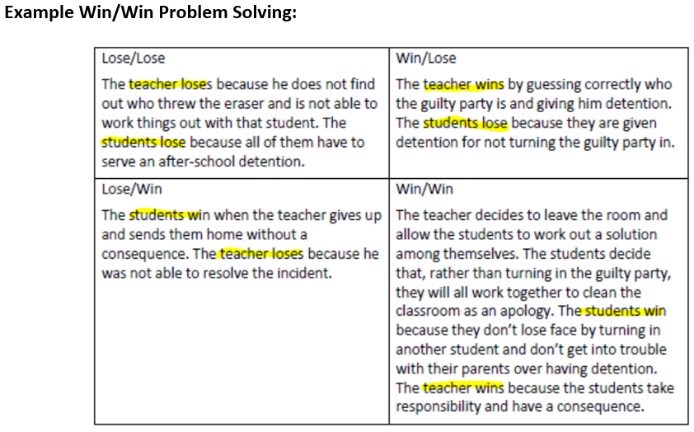

Slide 25
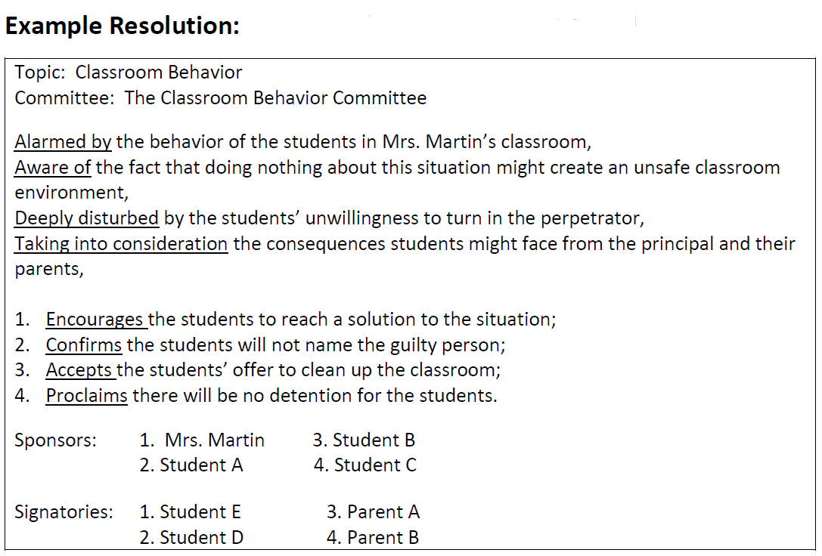

Slide 26
30 Second Persuasive Speech
Notes:
https://voicethread.com/share/10827185/

Slide 27
Model UN Conference
World history B
Notes:
https://voicethread.com/share/10876479/
Honestly, by the time we get to this assignment in Week 14 of Quarter 4, students are so well versed in VT and discussing by voice that it is almost anti-climatic!

Slide 28
Basic Structure
Vocabulary
Context (teacher)
Initial Thoughts
Background
Graphic Organizer/Notes
Discussion question (with prompts)
Respond to classmate (with prompts)
(Final thoughts)

Slide 29
Anastasia Martin
Minnesota Online High School
a.martin@mail.mnohs.org
651-764-6052

