Slide 1
Building Quality Online Experiences
Program Standards, Training, and Design

Slide 2
Hannah Hedegard
Lisa Abendroth
Kevin Henderson
Nancy McGinley Myers
Notes:
introductions

Slide 3
BACKGROUND
Hannah Hedegard
Program Director
Notes:
Mention that we're building master courses
Standards helped with recruiting

Slide 4
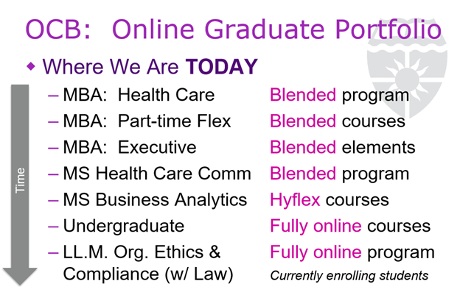
How did we know the time was right?
Existing bench strength with online and blended courses
  Portfolio as of November 2017:
Notes:
Blended offered in 2012. By Nov 2017 HC/Exec/PT, HCOM had blended. MSBA had high flex, UG and LLM had fully online courses

Slide 5
How did we know the time was right?
Momentum and support across the university
  Question wasn't should we, it was how do we?
Market data
Didn't require curriculum changes
  And could be built at a reasonable pace
Strength of instructional design team
All stakeholders agreed we needed a consistent, quality experience (enter: standards)
Notes:
Blended offered in 2012. By Nov 2017 HC/Exec/PT, HCOM had blended. MSBA had high flex, UG and LLM had fully online courses

Slide 6
Lessons Learned
Benefit to admissions/marketing messaging

Slide 7
DEVELOPING PROGRAM STANDARDS
Lisa Abendroth
Associate Dean,
Program Innovation
Notes:
My background
Marketing faculty with experience teaching blended
Prior faculty director for PT-MBA
First project as Assoc Dean

Slide 8
Why Standards?
Student Experience
  Bring best practices to online education
  Provide consistency and predictability
  Help students focus on learning content
  Build accessible courses
Instructional Design
  Build standards into templates
  Simplify faculty decision-making
Center for Teaching and Learning
US News
Notes:
Analogy to creating a book - we don't debate where the table of contents, binding, etc. goes. We can focus on the content
Standards helped with recruiting students – brings online student experience to life with concrete examples

Slide 9
Part 1: High Level Outcomes
Who: Faculty and Staff FOSTER Task Force
  Fully Online St. Thomas Experience Reimagined
Guiding Questions
  IDEAL learning experiences
  ESSENTIAL learning experiences
  Learning experiences to AVOID
Notes:
How did we develop standards…
Make-up of task force – who and why these people (experience teaching and/or student online) – Bottom-up process
Focus on the student experience that St. Thomas is known for. (Key faculty issue when decided to go online)
Start with framing how can online be BETTER than in person
Guiding questions in general and online specific (Sticky notes activity)
Nice to have
Must have
Must NOT have
WISH LIST

Slide 10
Part 2: Getting Specific
Who: Associate Dean + Instructional Designers
Inputs
  FOSTER high level outcomes
  Best practices in online education
  Required policies (e.g. accreditation, financial aid, etc.)
  Other standards (QM, OLC, other St. Thomas programs)
Draft 1
  Excel spreadsheet of standards by topic
Notes:
Who: + Faculty Director (Kevin)
Inputs: High degree of consistency between these items.
Considered what fits with our culture / what would be reasonable to our faculty (types and levels of standards).

Slide 11
Part 3: Feedback and Revision
Who: Faculty with online experience
How: 1:1 sessions
  Individual items viewed as reasonable
  Quantity of requirements viewed as overwhelming / excessive
Draft 2
  User-friendly format with links to standards by topic
  Delineate Standards (S) from Best Practices (BP)
  Indicate usage: Master (design) and Section (prep, delivery)
Notes:
WHO: B-school faculty (i.e. people we already know well)
… with ONLINE experience in grad LLM program and undergrad business program and TRADITIONAL and BLENDED (not online) experience with grad business programs

Slide 12
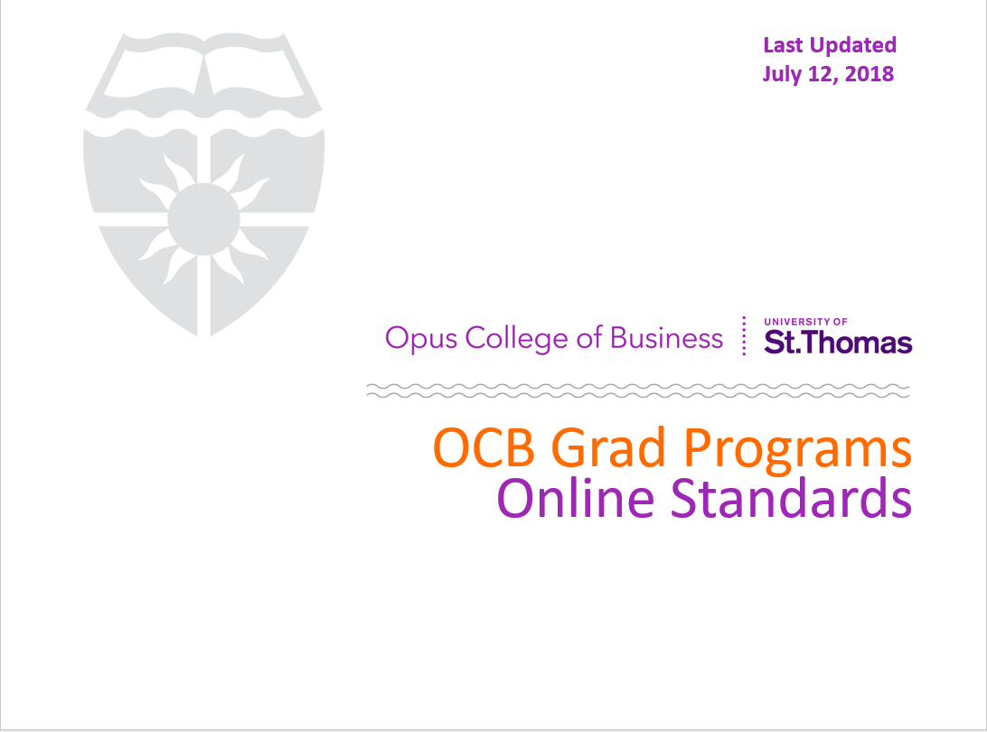
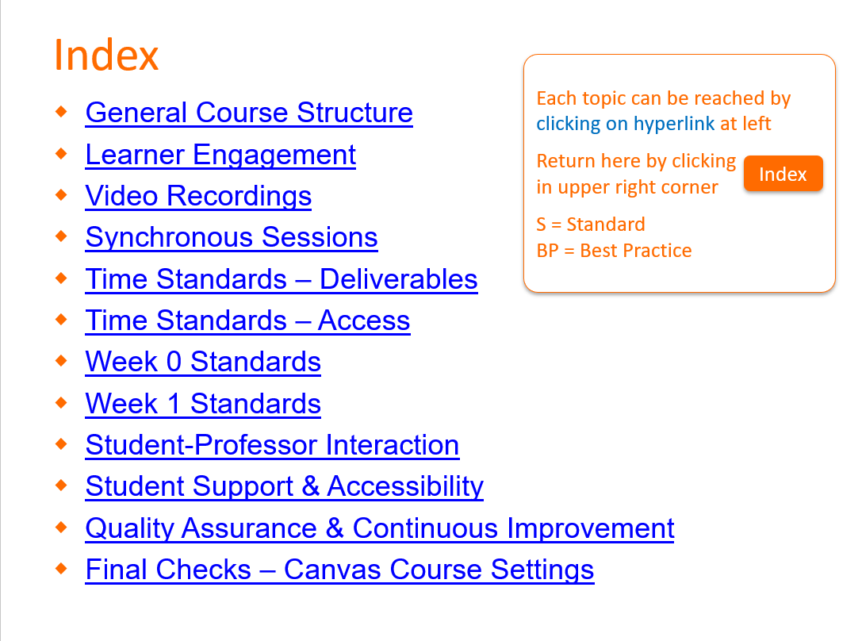
Draft 2
Notes:
POINT OUT:
Last Updated date (living document)
Index with hyperlinks – access standards as relevant (JIT)
General categories of standards (Note – happy to share standards themselves, but not the focus of this session).

Slide 13
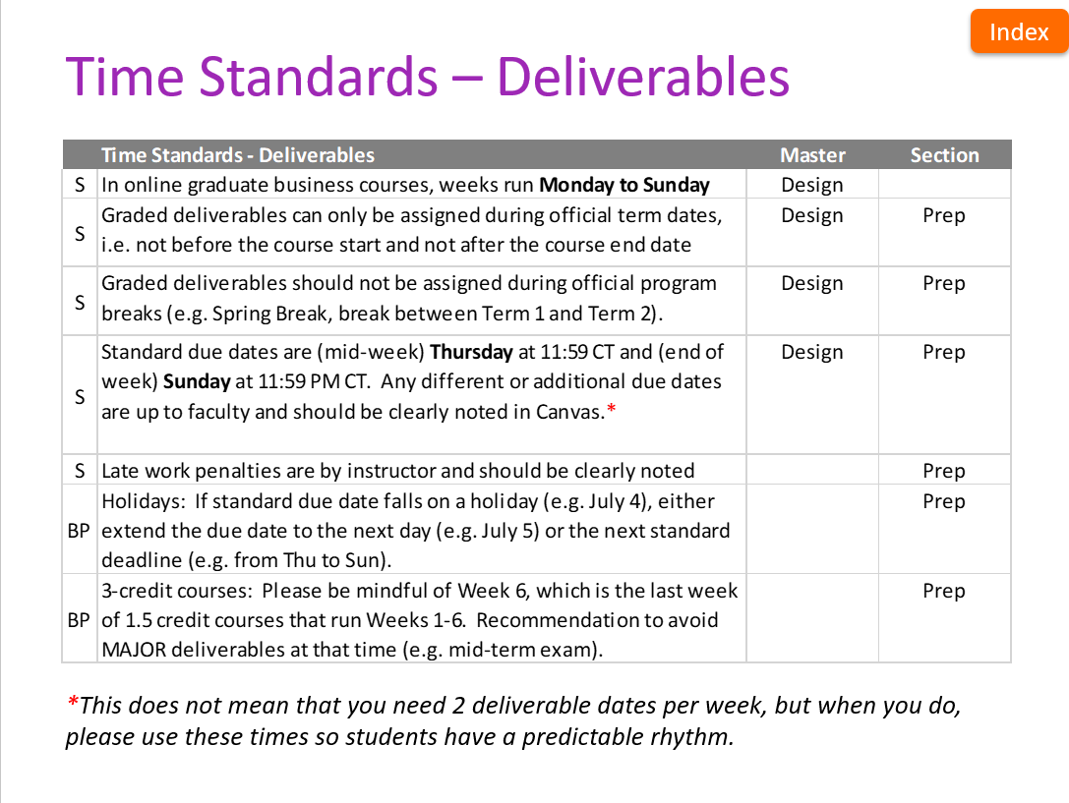
Sample Standards
Notes:
POINT OUT
Each page only shows relevant section from Excel spreadsheet (i.e. Draft 1) – never see all standards at once
Left column indicates Standard or Best Practice
Right side indicates whether consideration for Master or individual Sections, and whether should be part of the design process, section prep, or during delivery

Slide 14
Part 4: Broader Socialization
Who: FOSTER task force + all online faculty
How: 2 Zoom sessions (shared recordings & notes)
  Explained LIVING DOCUMENT with periodic updates as we learn what works best for our programs and students
  Reviewed logic behind standards
  Discussed concerns
  Asked for input and revisions
Notes:
Who:
People who shaped high level guidelines,
faculty with online experience (Validate usefulness and level),
faculty new to online delivery who will be adopting
Emphasized –
Living Document / constant Work in Progress
This version is starting point based on inputs from you, best practices, what we know now
these will change with your input as we gain experience and develop opinions

Slide 15
Lessons Learned
Involve key stakeholders early
Format for usability – design & delivery
Give options (e.g. Best Practices)
Living document for ongoing revision

Slide 16
ONBOARDING FACULTY
Kevin Henderson
Faculty Director
Notes:
My background
Faculty Director of the PT Flex MBA program, which includes the Online MBA program (curriculum and assessment)
Unicorn – Among first to teach in blended format. Taught first class in Online cohort this past Spring.
I was an early participant in the onboarding process.

Slide 17
Identifying Faculty
Experience
Enthusiasm
Elasticity
Department chairs
Notes:
One of the first steps in onboarding faculty is to be thoughtful about who you ask to teach online.
Three key factors we considered were 1) prior experience teaching online or blended, 2) willingness to give teaching online a try, and 3) flexibility in redesigning courses to fit online space.
At the end of the day, department chairs staff the course though and we don't always get our "first choice."

Slide 18
Instructional Design Process
Kick-off meeting (months ahead of time)
  Course design timeline
  Roles (ID, faculty, other staff)
  Program standards
  Training opportunities
One-on-one consulting moving forward
Notes:
Other staff: librarians and media specialists, student workers for course build and quality assurance
Note: ideally we would do the kick-off meeting a year in advance but there are barriers to doing that
Faculty see who else is going through the same experience (we do all faculty teaching the next semester, or two), so they can connect with each other for advice/support while developing their course.

Slide 19
Online Teaching
Online Teaching Certificate program
Conferences and workshops (e.g., OLC and QM)
Online Teaching faculty support groups
Notes:
Our university offers a three 5-week course certificate program through STELAR. This program focuses on the theory and practice of designing, developing, and facilitating exceptional online courses.
Funding is available to support faculty attendance at conferences and workshops that cover online teaching.
As noted earlier, faculty tend to connect with others teaching during the same semester, but faculty also tend to form connections with others in their department who are teaching online. We do a teaching conference every year and teaching online is a common topic across sessions. Finally, last year, I co-led a faculty learning community around online teaching that was supported by Faculty Development.

Slide 20
Lessons Learned
Be thoughtful about who you ask to teach online
Start early!
Provide support to faculty (e.g., orientation, training, specialists, therapy, etc.)
Notes:
It takes a long time to develop a course, so start as early as you can.
Faculty tend to be pretty resistant to change, so the more support you can provide, the better they will feel and, hopefully, the better their online classes will go.
Do any of you have a requirement or strategy for training faculty about teaching online?

Slide 21
COURSE DESIGN TIMELINE
Nancy McGinley Myers
Instructional Designer

Slide 22
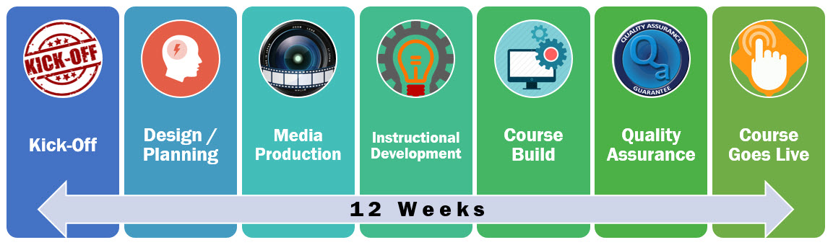
The Target Timeline

Slide 23










The Real Timeline
Notes:
Technical difficulties with being the first

Slide 24
My Attempts to Smooth the Way
Start early
Write up a project timeline
Biweekly meetings with agendas and action items (stored in a shared folder)
Onboarding Site
Canvas templates

Slide 25
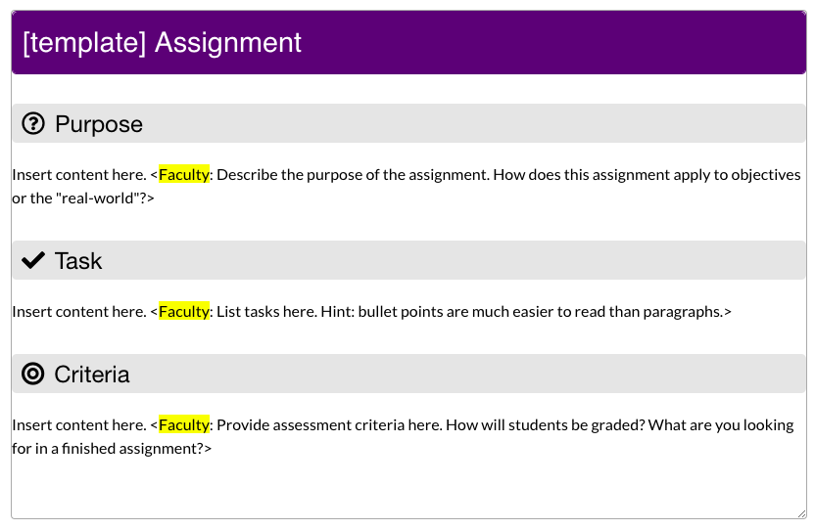
Templates
Best practices
Consistent navigation
Templates for:
  Getting Started Module
  Module Overview Pages
  Assignments
  Discussions
  Quizzes
  Module Wrap-Up Pages

Slide 26
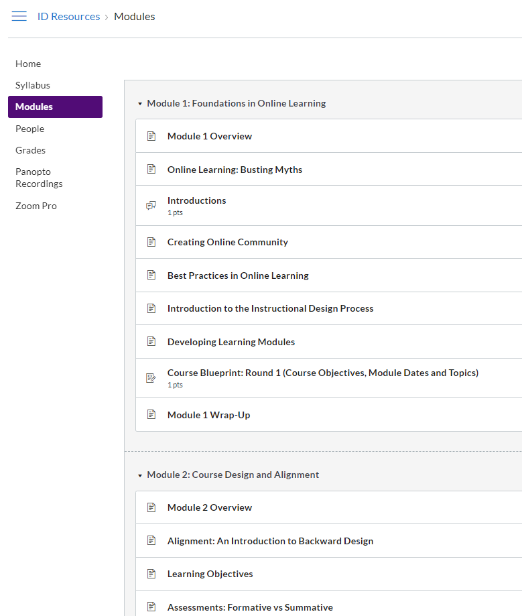
Onboarding Site
Foundations in Online Learning
Course Design and Alignment
Instructor Presence and Interactions
Activity Design
Canvas Site Creation and Accessibility
Sample Modules

Slide 27
Lessons Learned
Classes with extensive practice problems take longer to build
Designing over the summer takes more time
Spreadsheets to track course site build
Assume nothing!
Notes:
Quant classes need 9-12 months. They take a lot of planning and a lot more building. The planning might not take any longer (it's usually very sequential and logical) but the building takes A LOT longer due to practice problems, assignments, and videos
Don't assume that previous experience means the planning will go well/easily
Textbook integration is often tricky and takes a lot of time
Assume nothing:
-we identified blended/online but that doesn't necessarily translate to success and ease.
-Don't assume all the technology will work (semester after semester)-textbook integrations, video

Slide 28
QUESTIONS

Slide 29
RESULTS and NEXT STEPS

Slide 30
Results and Next Steps
Student Surveys on Delivery Format
  After each online course
  Gauge satisfaction and effectiveness of online format
    92% Thought the course design facilitated learning
  Specific questions about targeted standards (e.g. synchronous sessions)
Ongoing Discussions with Faculty
  What works well
  What are the challenges
  How can we improve the standards

Slide 31
Thank you!
Nancy McGinley Myers (mcgi0084@stthomas.edu)
Lisa Abendroth (LisaA@stthomas.edu)
Kevin Henderson (Hend7407@stthomas.edu)
Hannah Hedegard (hede0759@stthomas.edu)

