Slide 1
Creating an Interdisciplinary Online Textbook: A Case Study, and an Invitation to Contribute
Amanda Bemer, Lori Baker, & Lisa Lucas Hurst, Southwest Minnesota State University
Link to Textbook: http://otb.smsu.edu/

Slide 2
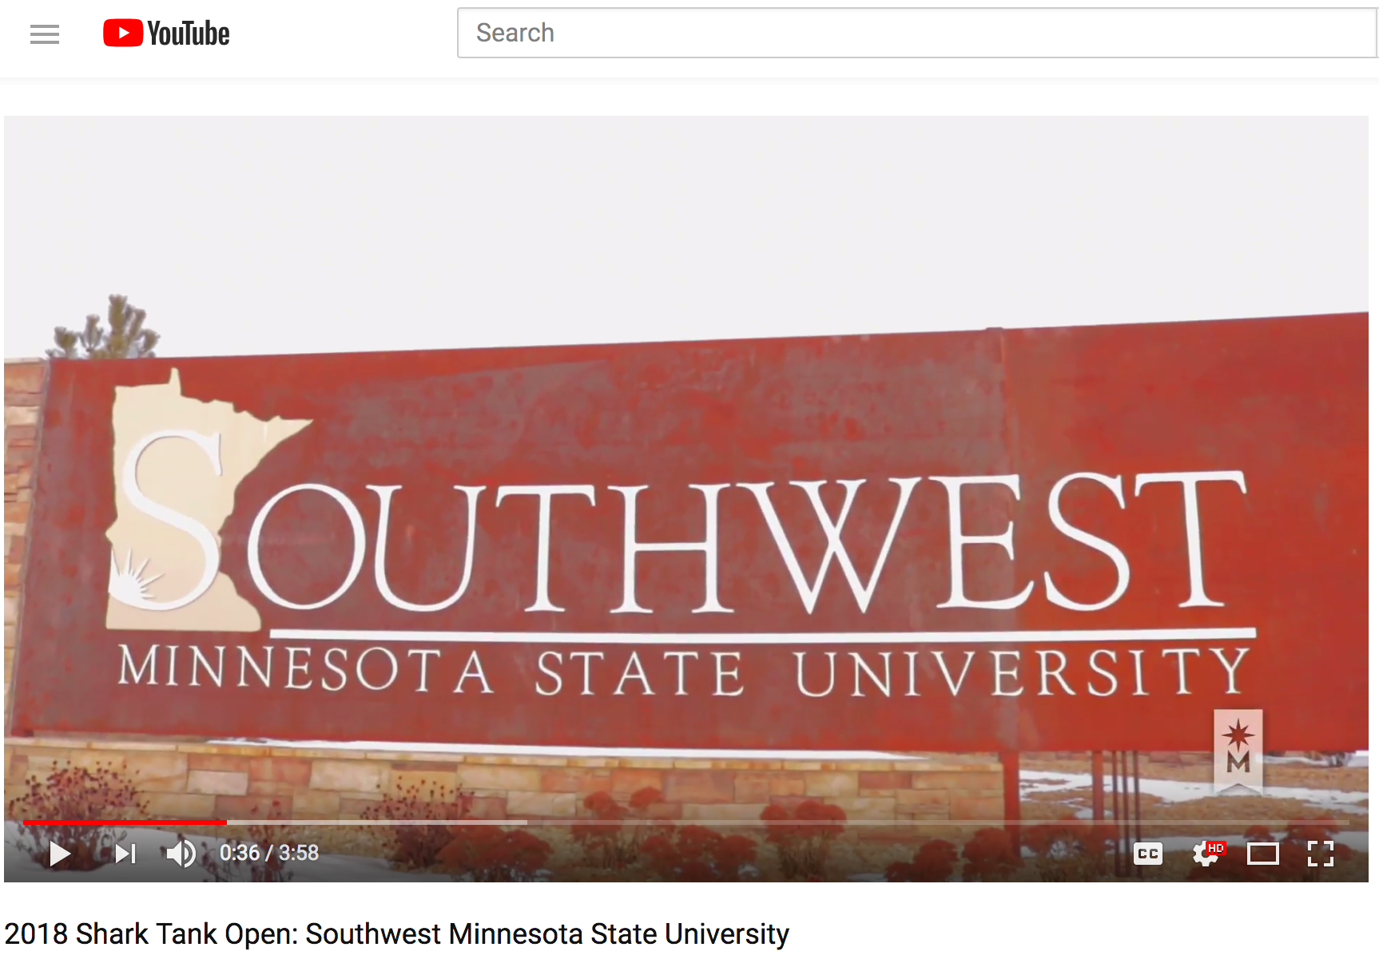
An Open Educational Resource Why Writing Works: Disciplinary Approaches to Composing Texts
https://www.youtube.com/watch?v=2dBEbBka018
Notes:
Our open textbook project, titled Why Writing Works: Disciplinary Approaches to Composing Texts, was funded by a grant from MinnState, through an Educational Innovations “Shark Tank” grant. This video created by Minnstate to promote its grant projects provides an overview of the project.
Video is 4 minutes.

Slide 3
Audience Interests
What brought you to this session today?
Are you planning or hoping to create an open textbook?

Slide 4
Outline of Today’s Presentation
Overview of project
Aspects of the creation process (time for ?s after each):
Invitation to Collaborate
Q & A

Slide 5
Catalysts
ENG 251 Writing in Professions needed a better textbook
Unique course
Instructors piecing together content
Textbooks not fully utilized
Cost
Online/multimodal text fits online/hybrid format of course
Writing is becoming more digital
Customizable to our signature programs
An always-accessible online resource for students and instructors
Notes:
ENG 251 Writing in Professions is a sophomore level course that introduces students to writing, reading, research, and documentation in their disciplines. This approach requires borrowing the expertise of professors in other disciplines, and most textbooks we found did not address the disciplines in the way we envisioned, and none covered all the disciplines we wanted them to. The best option we found was still not fully utilized, and it’s $140 new. The online textbook fills a gap.
There are rhetorics that cover some of the pieces but not all; we wanted more examples and explanations out of the disciplines most relevant to SMSU students.

Slide 6
Components of the Open Textbook otb.smsu.edu
Two primary sections
“Writing in Professions” (broader explanations about professional writing practices)
“Disciplinary Perspectives” (discipline-specific information about writing, reading, research, and documentation)
Annotated examples of professional and student writing
Many videos:
students discussing their writing practice
faculty describing writing in their fields
Librarians explaining research process
Links to external resources
Notes:
Hyperlinked throughout, cross-referenced (multiple ways to arrive at the different types of information listed on this slide)
TABLE OF CONTENTS:
In the first section, there are many SHORT videos of students explaining the value of the course and explaining how to recognize genres of sources. Using students in videos pulls students in to view them.
The LIBRARY section has multiple videos from our own librarians (they are often required to do a library consultation for this course). There videos are much longer. We intend to have the videos over 10 minutes broken into shorter videos.
The Environmental Science section is the best to pull up and walk through, since all the components are there. This documentation section is particularly noteworthy because it highlights the customizability of this text. (Note the headline that says Documentation in Environmental Science at SMSU.)
Sections on Ethics and Standards of Practice link back to Amanda’s section on commonplaces.
Emphasis on videos

Slide 7
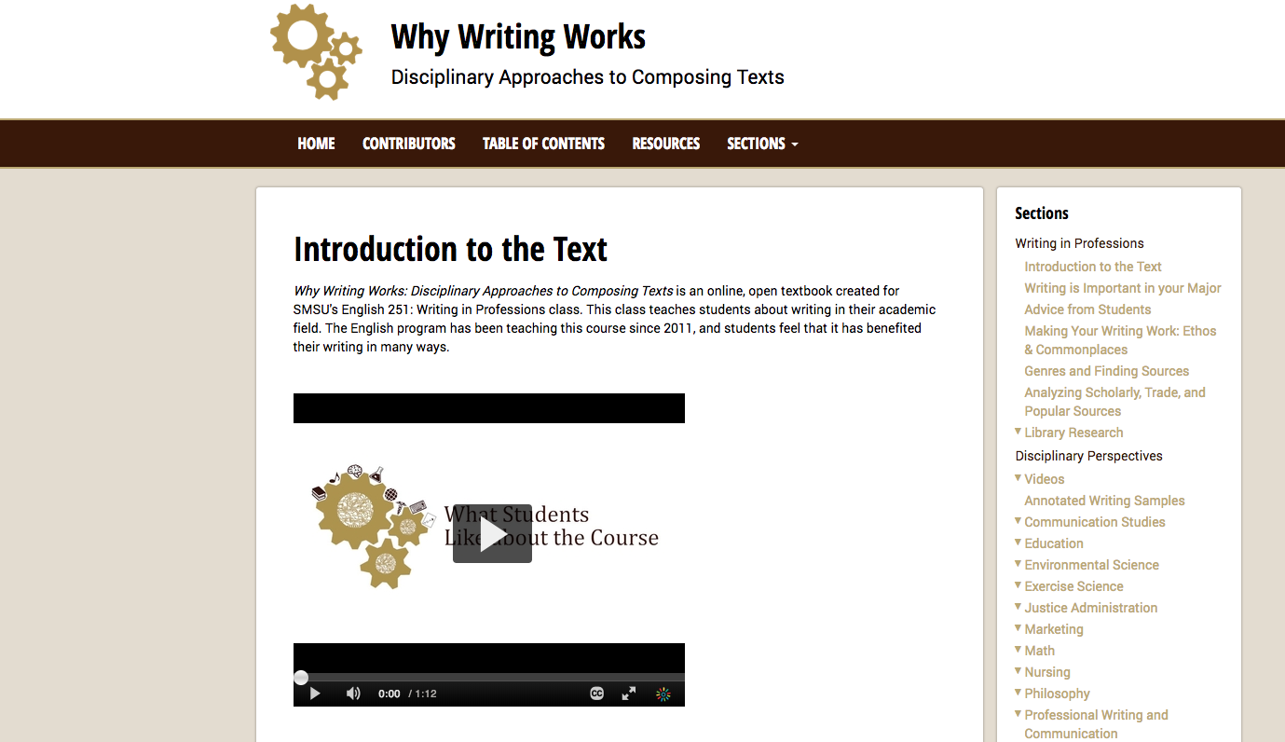
Notes:
Screenshot for repository version

Slide 8
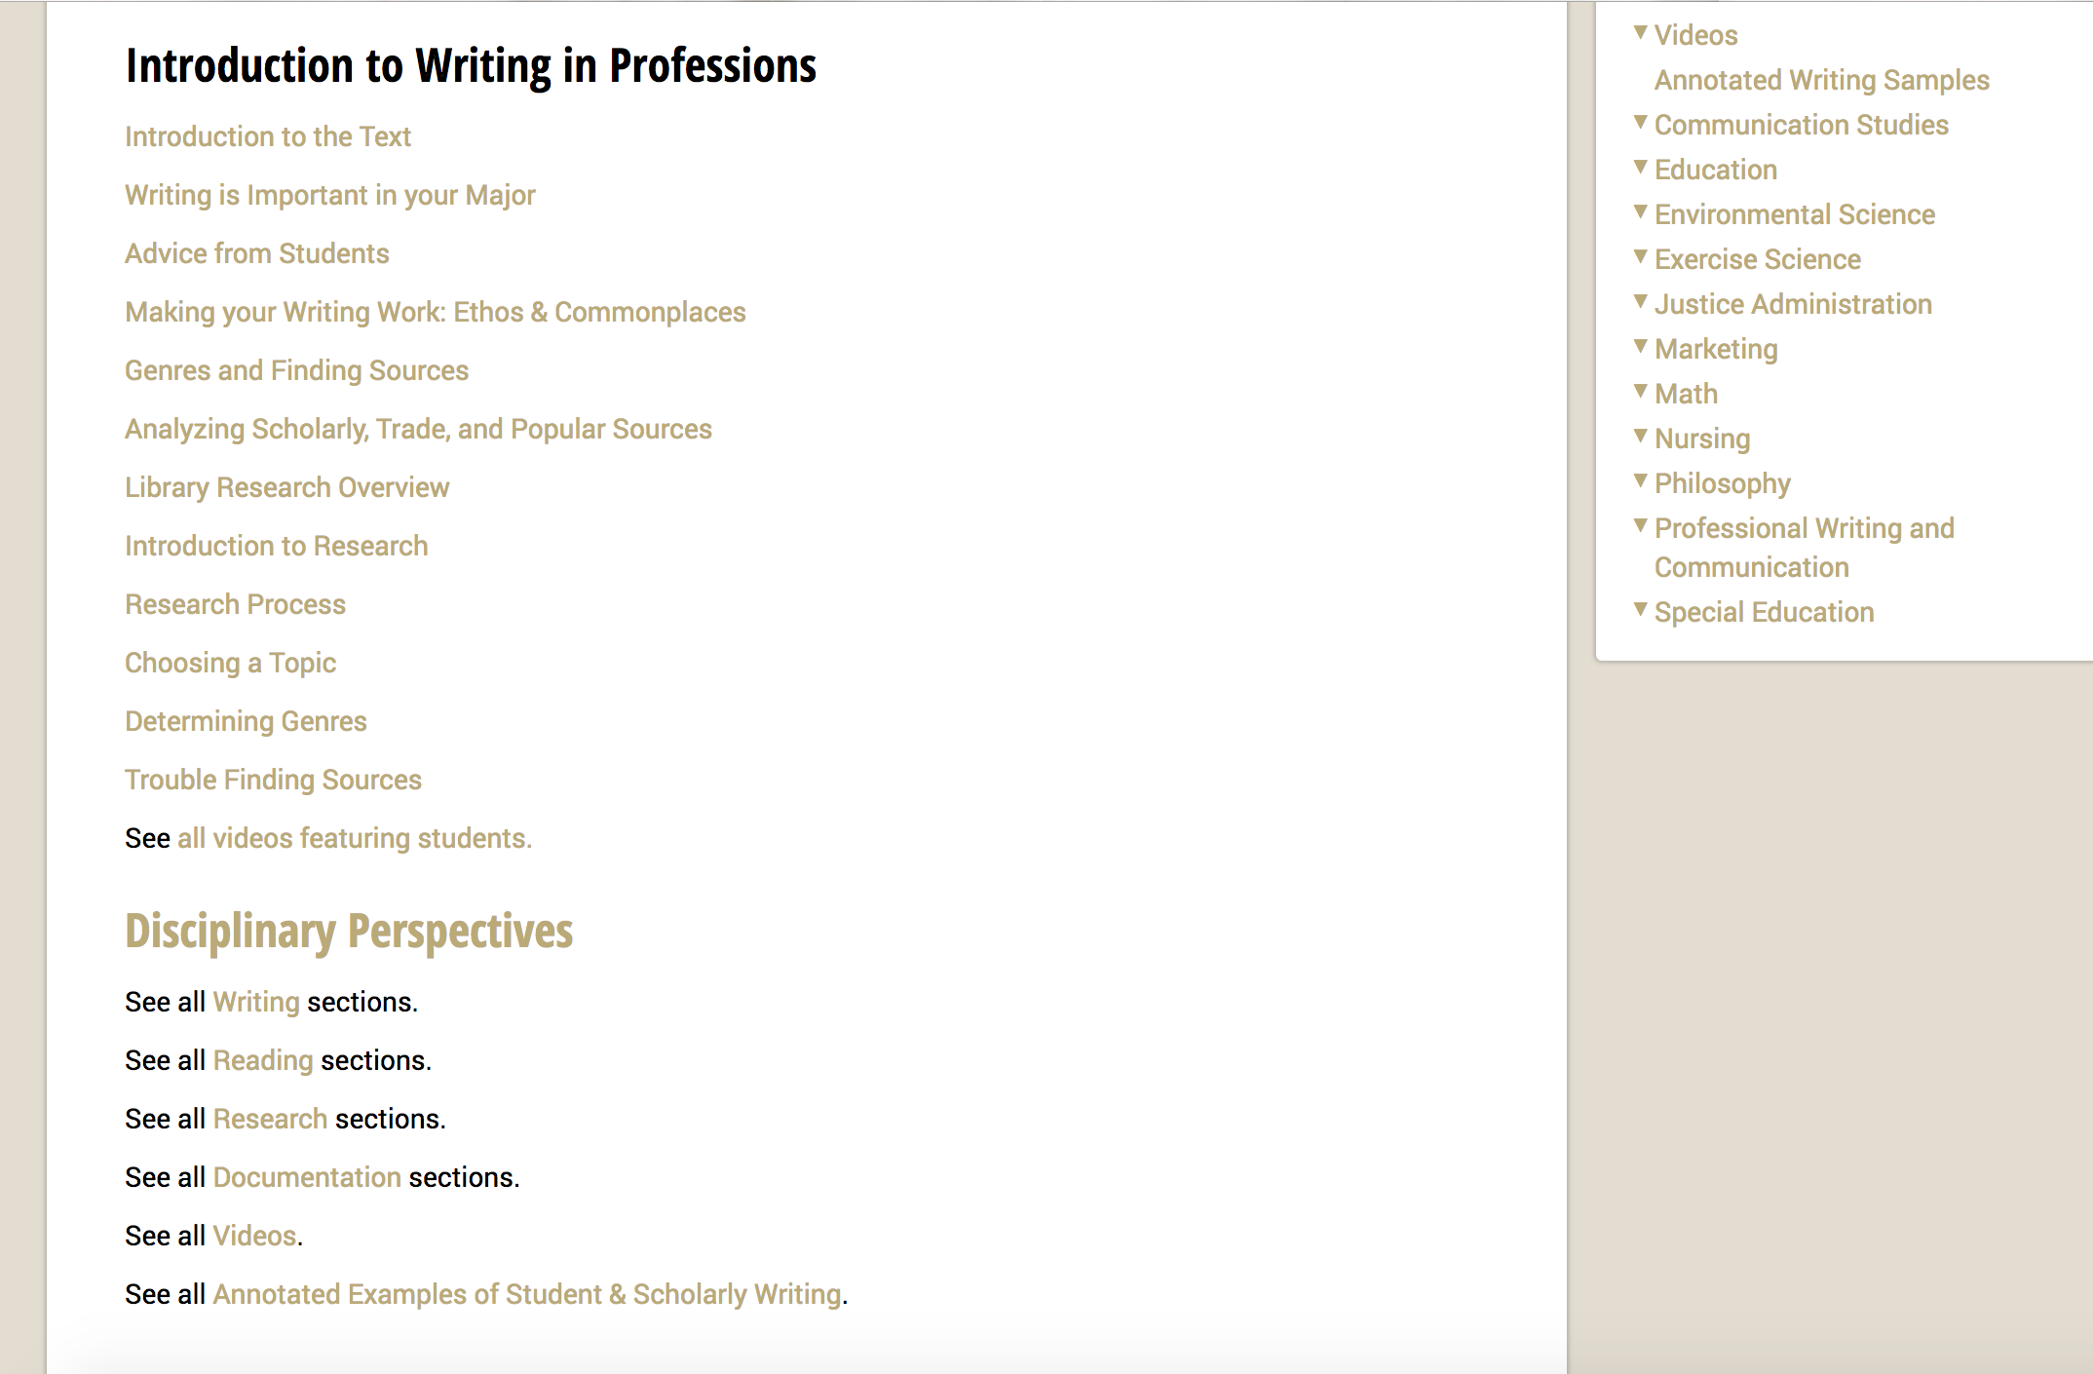
Notes:
Screenshot for repository version

Slide 9
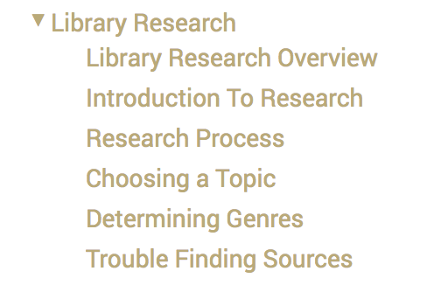
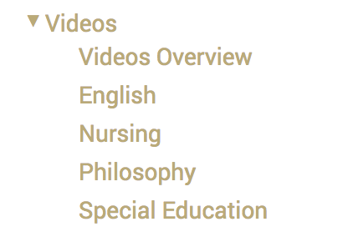
Notes:
Screenshot for repository version

Slide 10
Notes:
Screenshot for repository version

Slide 11
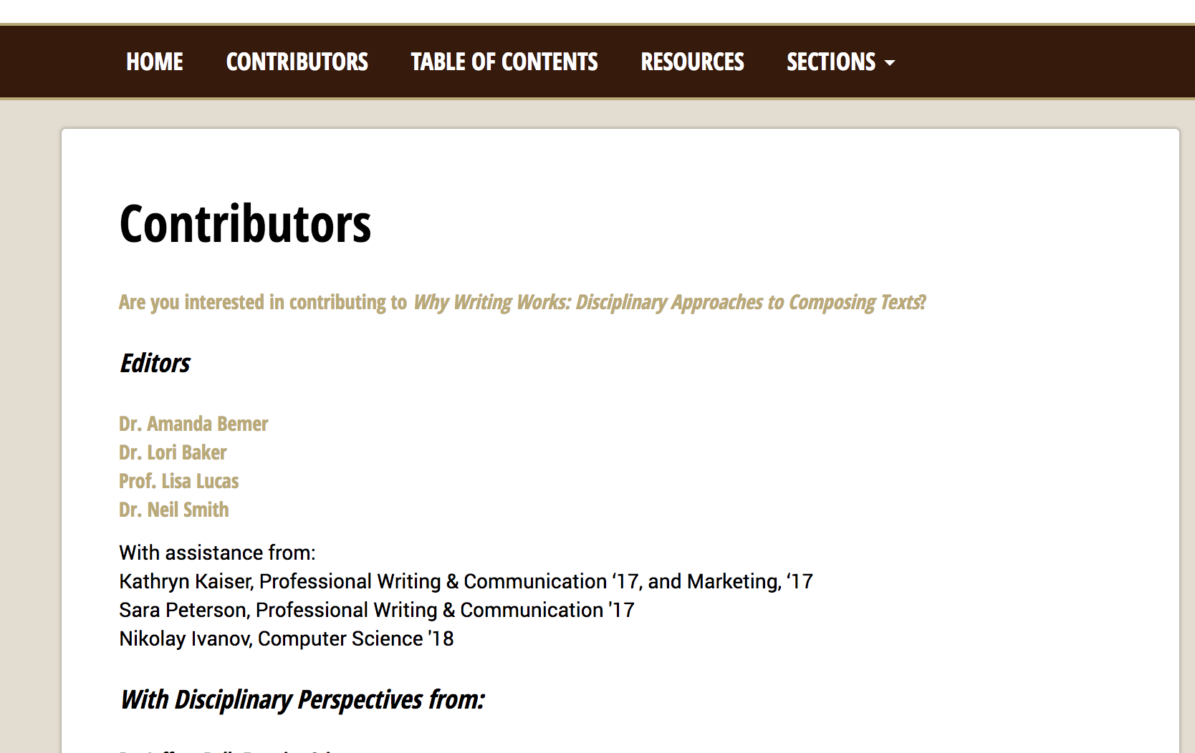
Notes:
Screenshot for repository version

Slide 12
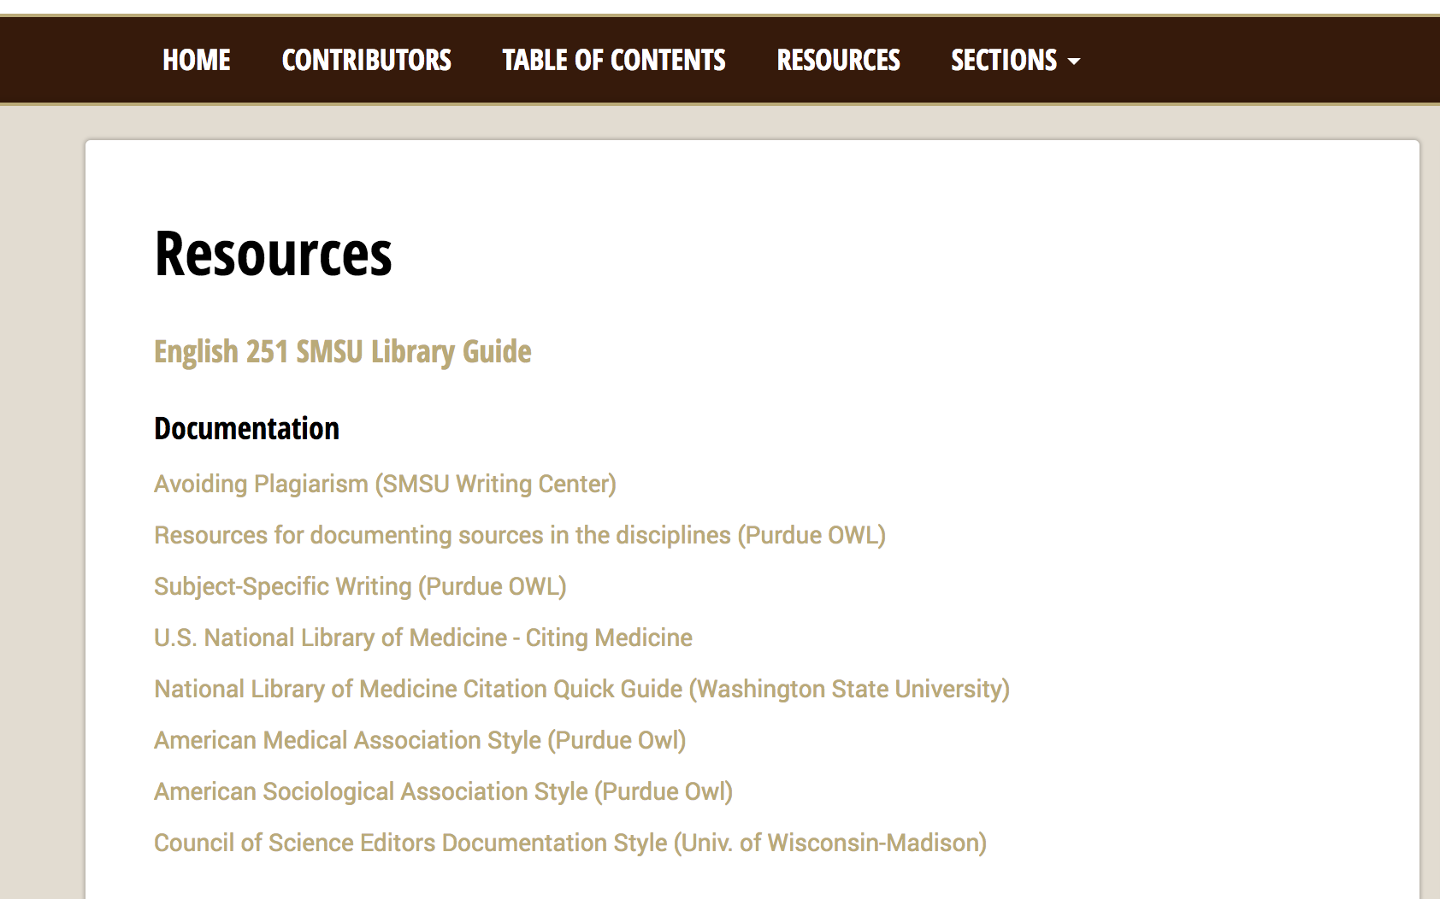
Notes:
Screenshot for repository version

Slide 13
Timeline
November 2015 Initial discussions
December 2015 Grant due
February 2016 Grant awarded
Spring 2016 Design and prompts for faculty created; first call for materials
Spring 2016 Legal and technical planning
Summer 2016 to now Faculty development of materials
Fall 2016 Second call for materials; hiring of students for videoing, captioning, and animating the annotations
Fall 2016 – Spring 2017 Videos of faculty and students; student developed the annotation pop-up
Summer 2016 – Spring 2017 Campus changeover to a new web content system (delay in making it public)
Spring 2017 Pilot sections of the text in two 251 classes
Spring 2017 Debut to campus with reception
Fall 2017 -- Spring 2018 Ongoing development of additional disciplinary perspectives and textbook components
Spring 2018 Filming of Shark Tank Video
Spring 2018 Exhibited at Shark Tank Open
Spring 2018 Analytics and evaluation of usage and design
Summer 2018 Moving forward with continued development of content and opening up contributions from outside of SMSU

Slide 14
Question
Now that we’ve shown you what we did overall, what are the types of issues or questions that are popping up for you?

Slide 15
Aspects of the Creation Process
Collaboration
Technology
Legal
Costs/Budget

Slide 16
Collaboration
Collaborated With multiple stakeholders
Initial Grant-writing Group and Department
Interdisciplinary Faculty
IT
Business Services and Administration
MinnState
Student Workers
Students Using the Text
Future collaboration
Reaching out beyond SMSU
Lessons learned
Notes:
Faculty partners include librarians
Facilitating the work the faculty did with their students (student samples) and professional articles; working with the faculty union to approach this correctly
MinnState = grant guidance, legal
BENEFITS:
Closer working relationships with faculty from across campus because of one-on-one interactions
Creating a dialogue on campus around issues of reading, writing, research, and documentation (and what’s going on in this course in general)
We learned more about reading, writing, research, and documentation in various disciplines and specific professors’ approaches, which helps us prepare students better
Working at the system level helped us meet and collaborate with great people, and provided resources we would not otherwise have had access to
Opportunity to continue to collaborate and build out the resources with people from across the system and globally
Lessons to share:
Buy in from faculty: duty days helped, as did pointing out that this was an opportunity for them to influence how students will be prepared coming into their majors and an opportunity for an item in their vita.
Set reasonable deadlines
Have a carrot and stick – paying for faculty contributions was necessary, but we also needed a better mechanism to ensure they would follow through, although also have to accept that sometimes there are factors beyond your control (hospitalization, larger budget and campus issues)

Slide 17
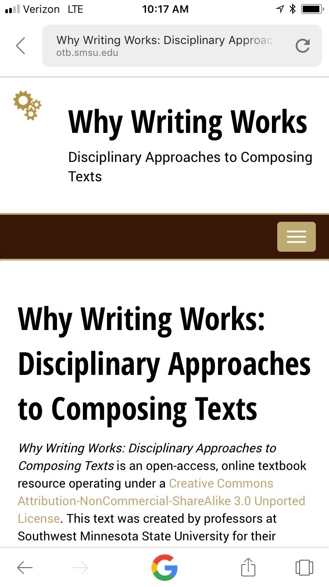
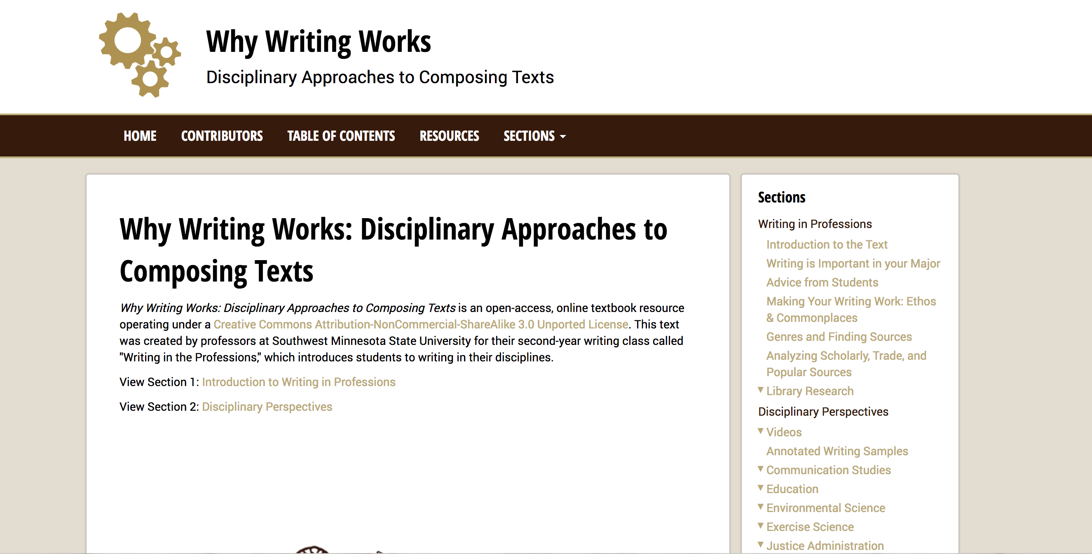
Technology
Mobile version of site
Desktop version of site
Notes:
This project would not have been possible without our excellent IT staff, student workers, and Amanda’s one semester sabbatical in Fall of 2016. Our SMSU web administrator (Joe Zimmerman) created the template for the site (in coordination with Amanda). This was while we were transitioning to a new web management system (Cascade). We essentially were SMSU’s test case for the system. Our site is hosted on the university server. The beauty of the new system is that it also adapted our site for mobile, which we accounted for in the design of the site.
We chose to make our site a hyperlinked web site instead of a pdf (or ereader format) for usability purposes and for flexibility. We wanted to keep updating our site as things changed—a book format would require us to “publish” the ebook and be done with it. Also, we wanted to have the ability to include videos (which were embedded from MediaSpace, not technically hosted on the site) and to use rollover annotations for our writing samples.
Our computer science major student worker was invaluable in creating the rollover annotations with coding. Our English majors assisted with captioning the videos, creating the logo for the site, and doing some light editing.
Lessons learned: I would totally do it again as a website-–but it’s important to have a good relationship with your web administrator. I broke the textbook site maybe 5 times… ☺ He always figured out how and why and fixed the system. It’s also very a time-consuming—without a sabbatical, we wouldn’t be as far along with the site as we are.

Slide 18
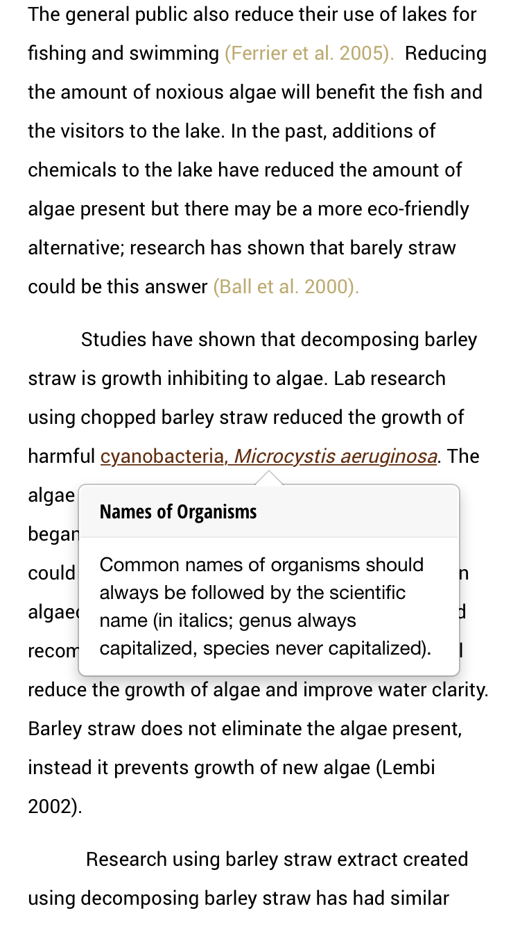
Technology, cont.
Rollover annotation example from Environmental Science student writing sample.
In the mobile version, you click on the highlighted text and the annotation pops up. (In the desktop version, you hover over the highlighted text to make the annotation appear).
http://otb.smsu.edu/annotated-works1/envscience-student-annotated-Effects of barley extract on the growth of algae.html

Slide 19
Why is an online textbook superior to a print textbook?
The obvious answers:
always accessible, impossible to lose
cost (U. Georgia study)
The concept of a print textbook is arguably outdated
Customizable
Online texts also provide the opportunity for input from many
The format is more familiar to students
Notes:
Why is an online textbook superior to a print textbook?
The obvious: 1) always accessible, impossible to lose, all students can afford it: i.e. there is NO EXCUSE for not having the textbook☺ They can access it via their cell phones! 2) COST!
The concept of a print textbook is arguably outdated: information and knowledge changes so fast that a printed textbook—which implies an authoritative stance—runs the risk of being out of date/out of touch very quickly. In contrast, online texts can be updated continually, whether in major or minor ways, which is a more accurate reflection of information/knowledge creation in today’s world. (Reference ACRL frameworks?)
Customizable: We could create a text that fit our course exactly rather than have a text that we only partially used. We could highlight programs from our own campus for which we were not likely to find examples in traditional textbooks: We could prepare students in a more precise way for their future professors.
Online texts also provide the opportunity for input from many sources—we are asking for contributors from more disciplines today, for example. We can reach not only throughout MN, but all over the country and even the world. We could reach out to former students who are now in the work force for examples of writing in their profession. In this way, many people are creating a better wheel, rather than a few creating or re-creating a wheel.
The format is more familiar to students: they are more adept at navigating websites than in navigating textbooks. (They may have negative associations with textbooks.) They are fine with adaptations, additions, etc.

Slide 20
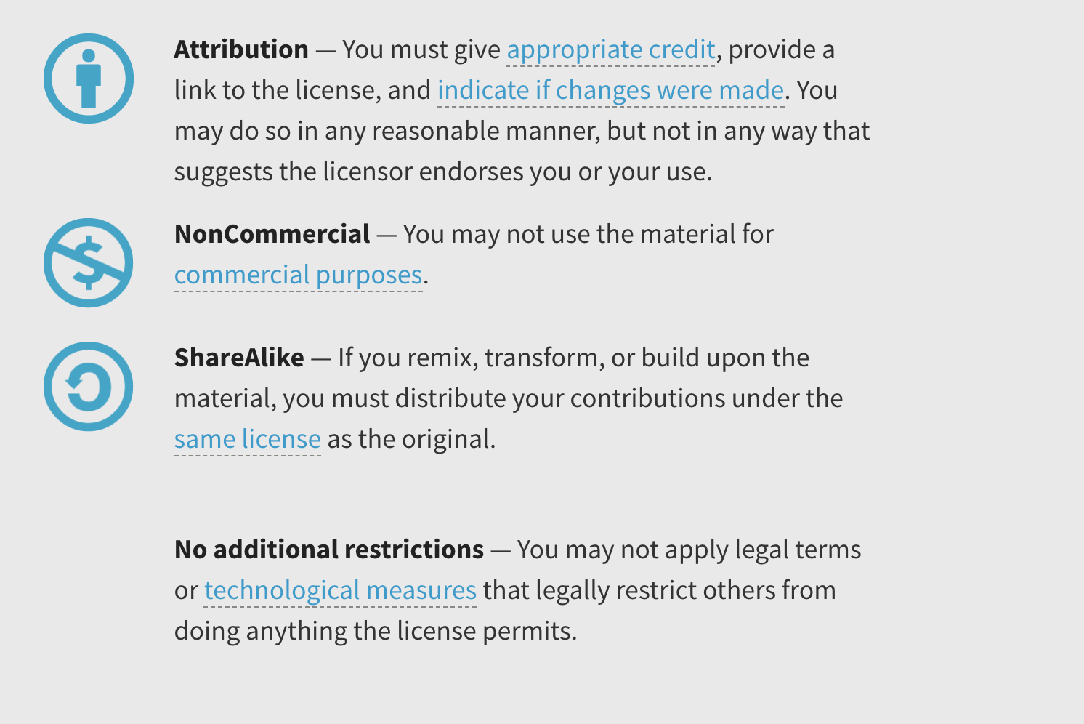
Legal Issues
Creative Commons license information https://creativecommons.org/licenses/by-nc-sa/3.0/
Notes:
We worked with Minnesota State’s legal counsel to create our contractual agreements with faculty and students to use their work, and for our permissions contract for outside articles. They helped us get the wording right and were invaluable as well.
We decided to use a Creative Commons license in the spirit of OER—others can use the material if they attribute it correctly, share the same as we do, and don’t profit from the material.

Slide 21
Costs/Budget
Budget categories
ROI in first year of open availability (2017-2018)
7 sections
175 students
Previous textbook = $140
Total savings of $24,500
Lessons learned
Time is money
Document use of internal resources
Budget for the unexpected/unanticipated
Notes:
Had an original Shark Tank grant for almost $25,000, though that was before the current Shark Tank format of live appeals
Our budget categories included faculty duty days, which was the primary cost since we needed the materials to be developed rather than the software or hardware to acquire or drive it (aculty days = 22.500; 171 student stipends; 1650 student workers; 200 hard drives and photocopies, no copyright ended up being needed; 350 reception )
Other categories were copyright clearance, which we didn’t need, photocopying or software licensing if needed, student worker salaries, small stipends to pay student contributors for sharing their work, and money for a reception to debut it and garner some PR.
That was something of a guess, but we met with IT to discuss needs and concept before submitting the grant. They agreed to help and that their part would essentially be part of their ongoing work with faculty. That meeting and discussion was vital to set the stage for us to continue, and it also serves as a lesson moving forward, to consider any type of in-kind help even if it isn’t mandated by the grant requirement. You WILL need help or use resources of some kind. The legal help from the system could be considered another type of in-kind, as our original budget for copyright clearance didn’t consider any other type of legal assistance.
Even if no in-kind is required, consider how to document use of internal resources to demonstrate institutional/organizational commitment
Grant requirements will drive level of preciseness, but budget for the unexpected/unanticipated
As we continue work on the project, we wish we would have budgeted for a tablet or mobile device of some kind, as that would help us moving forward to test the mobile aspects, so that was an unanticipated cost, although that is something that came up as the project evolved.
Our main lesson and one we felt we anticipated is just that the time to create and develop and implement this project really needed to be compensated to get it off the ground. Hence our primary budget item of duty days for faculty to create the materials. We won’t have duty day monies moving forward unless we can win another grant, but now that the original project has been seeded and is showing some success, we have a track record to apply for additional grants, and there are also alternative ways to approach it such as factors in load.
Ask for all of the grant money and use it all up!

Slide 22
Invitation to Participate
Notes:
On the handout we gave you as you came in, you have an invitation to contribute. Please share with professors on your campus.
Guidelines for contributing are also found on the website. We ask that contributors respond to various prompts about writing, reading, research, and documentation in their disciplines, and that they provide annotated writing samples. For consistency’s sake, we maintain editorial control.
This could be a textbook that serves students and instructors all over Minnesota, the country, and even the world. We invite you to be a part of it.

Slide 23
Discussion

