Slide 1
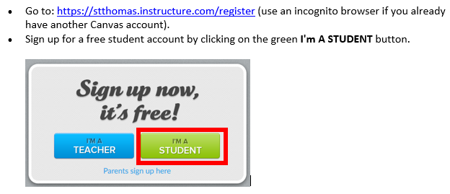
Log in to Canvas
Join Code: EN9C46

Slide 2
New Academic Technologies Support the HyFlex Course Delivery Model

Slide 3
Presenters Glori Hinck Instructional Designer Dan Hoisington Director AV & Classroom Technologies Jim Shovein Clinical Faculty, Finance Lisa Burke Director STELAR Minneapolis

Slide 4
The HyFlex Model

Slide 5
HyFlex (Hybrid + Flexibility)

Slide 6
Single Course
Flexible
Participation
Policy
Face-to-Face
CHOICE
Synchronous Online
Asynchronous Online

Slide 7
Student Choice
Change mode of attendance daily, weekly, by topic, according to need, or by preference
Instructor tailors content for each delivery mode
Some elements the same, others different
Often, same high stakes assessments regardless of chosen path

Slide 8
ADULT LEARNERS
Learning styles & needs
Maximizes effectiveness of instruction
High degree of customization
Control over learning process

Slide 9
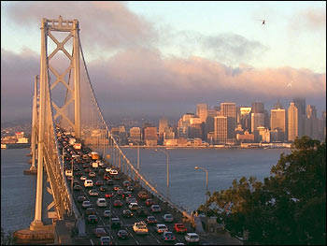
2006
Dr. Brian Beatty
San Francisco State University
Challenges faced by graduate communter students

Slide 11
LEARNER CHOICE
REUSABILITY
EQUIVALENCY
ACCESSIBILITY

Slide 14
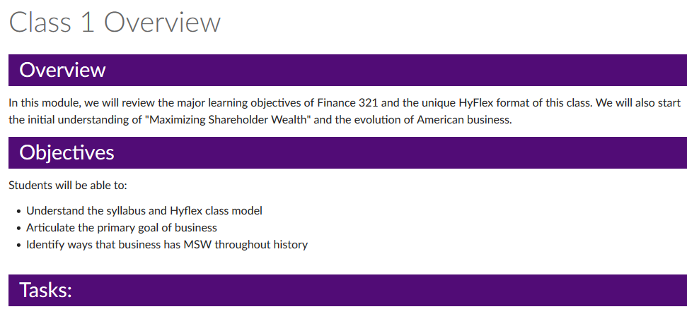
Canvas Modules

Slide 15
Instructor
Instructional Designer
Student Room Monitors
Students
Administrators
Registrar
AV and Classroom Support
Notes:
Dan

Slide 16
Instructor’s Technologies
Technology | Purpose
SmartBoard | Display PowerPoints and allow live annotation
Zoom | Highly interactive virtual conferencing tool
Panopto | High quality video recording of class lectures
VoiceThread | Content and video creation / sharing tool
Proctorio | Online proctoring service ensuring exam integrity
Canvas LMS | Organizes and helps ease use of technology
Notes:
Dan

Slide 17
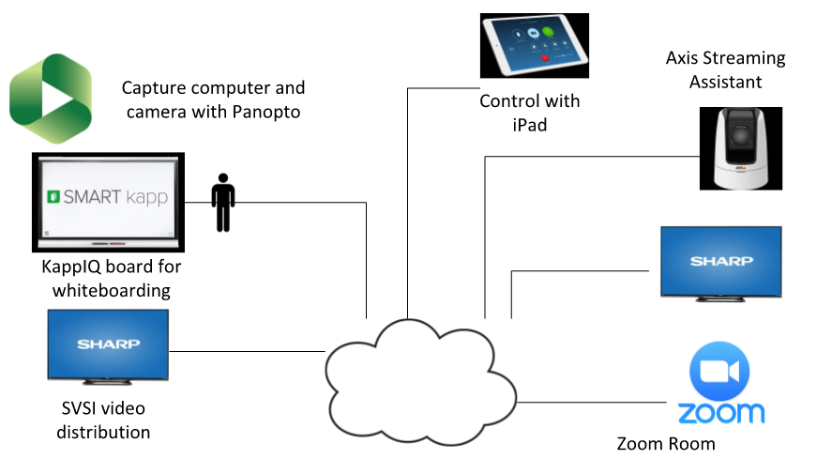
Classroom Technologies
Contact Dan Hoisington at hois4443@stthomas.edu for technology details
Notes:
Dan

Slide 18
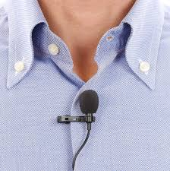
Enhanced Audio
Notes:
Dan

Slide 19
‘Traditional’ Classroom Experience
Panopto
Smart Board
Active Learning Classroom
Notes:
Dan

Slide 20
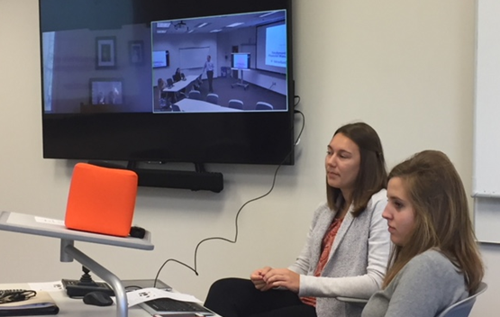
Synchronous Online Experience
Zoom
Student Workers
Chat, Camera, Throw Box
Notes:
Dan

Slide 21
Panopto Lecture Recording
Notes:
Dan

Slide 22
Notes:
Dan

Slide 23
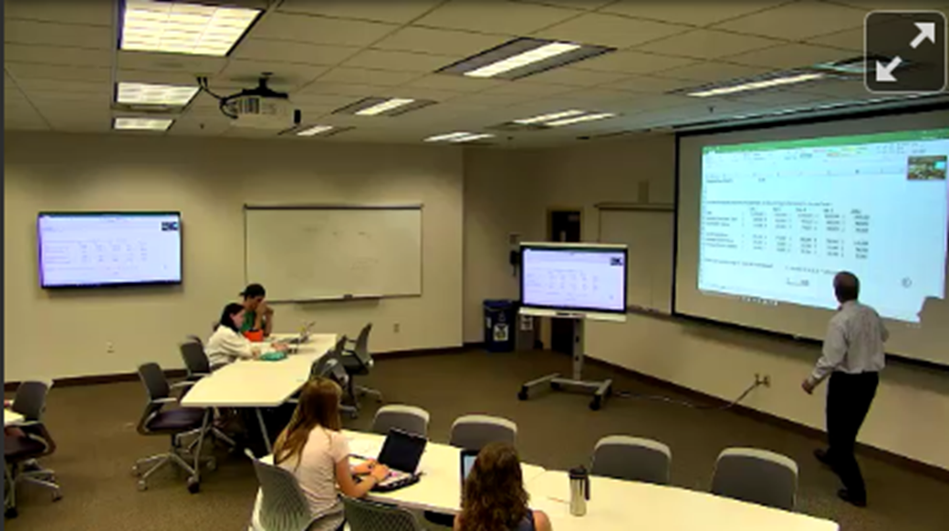
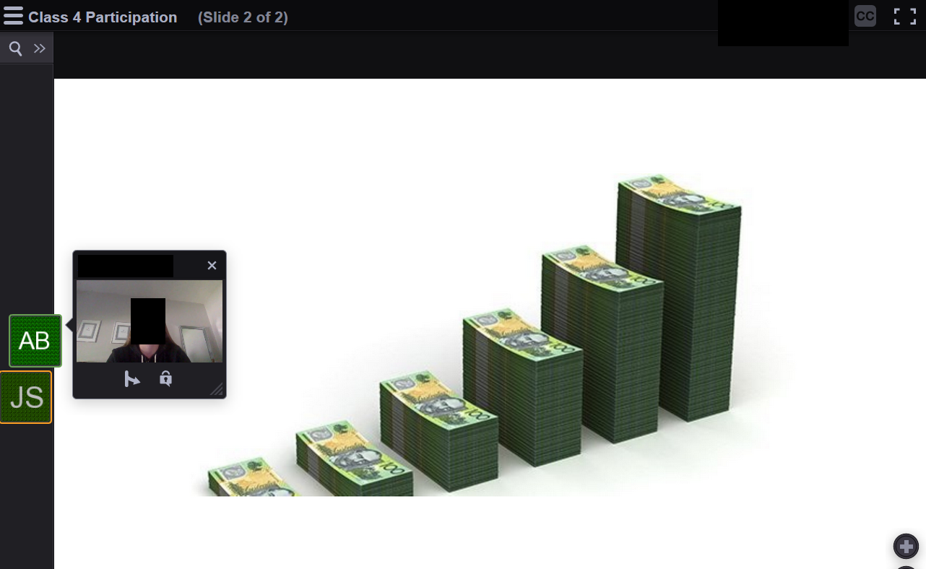
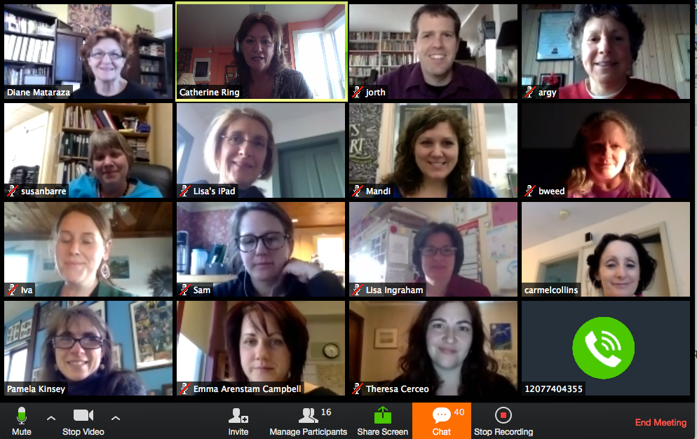
Multimodal Discussion Options
Classroom
VoiceThread
Zoom
Notes:
Glori

Slide 26
Attendance
Old ‘Traditional’ Summer FINC 321
16 students
Summer 2017
Originally capped at 20
Due to demand, cap raised to 40 with wait list
Final enrollment 39 students
Summer 2018
Capped at 50 with wait list
Final enrollment 48 students

Slide 27
‘Average’ Attendance 2018
48 students total
Face-to-Face | 6 students | 13%
Synchronous Online | 3 students | 6%
Asynchronous Online | 38 students | 81%
Notes:
.

Slide 28
Instructor ‘Hunch’
8:00 a.m. class time…. more asynchronous

Slide 29
Continuous Quality Improvement

Slide 30
Better integration of Zoom into the classroom
More deliberate engagement of the sychronous students in lecture and discussions
Use of virtual break out rooms with report back to entire class

Slide 31
Panopto
Instructor used the Smartboard annotation tool more
Recordings were more than just static PPT slides
See and hear how analysis was built

Slide 32
Classroom Camera
Tried to improve camera angles so that asynchronous student experience was closer to a classroom experience
Per instructor, “Not as effective as I would have hoped”

Slide 33
VoiceThread
Students created short PPT presentations with video narration
Per instructor, “dramatic improvement in engaging online students” compared to discussion board

Slide 34
Evaluation

Slide 35
Evaluation
Course Evaluation 4.5/5.0
Instructor Evaluation 4.5/5.0
Average student GPA’s ~same as traditional face-to-face version

Slide 36
Qualtrics Survey
Qualtrics Survey
19/48 responded (40%)

Slide 37
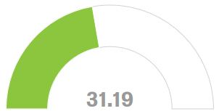
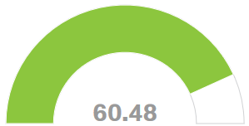
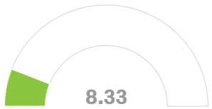
Face-to-Face
Online Asynchronous
Online Synchronous
Approximately what percent of the time did you participate in each type of learning over the term?

Slide 38
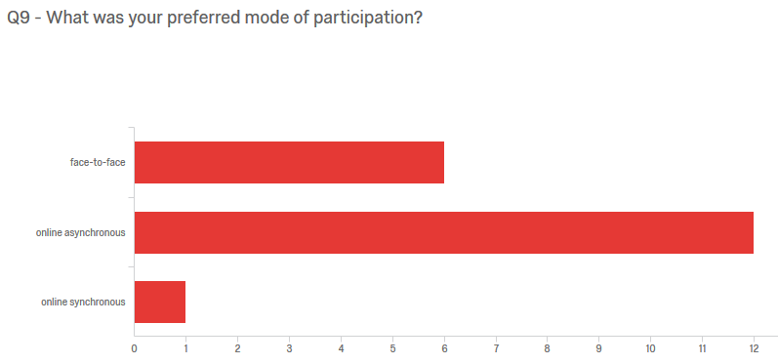
What was your preferred mode of participation?

Slide 39
Both Online & F2F instruction were considered useful

Slide 40
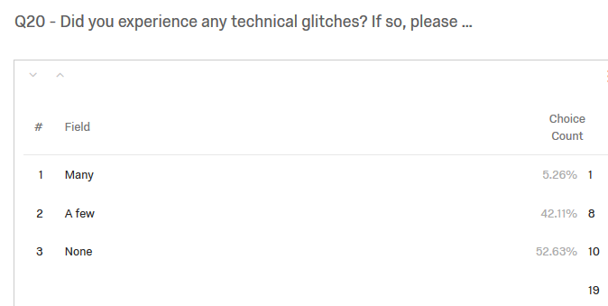
Few Technical Glitches

Slide 41
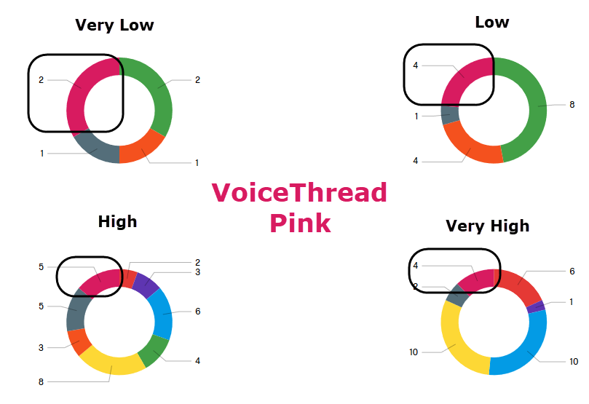
Please rate the value of each of the following learning activities used in this HyFlex FINC 321 class from very high to very low; select n/a if you did not participate in an activity.

Slide 42
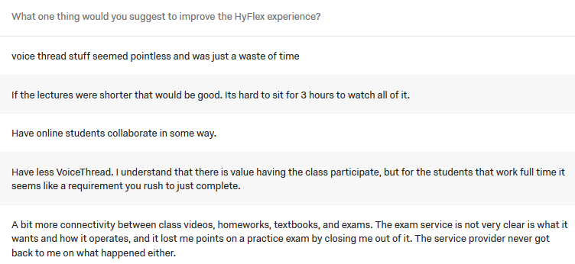
What one thing would you suggest to improve the HyFlex experience?

Slide 43
Instructor Quote
“The critical thing to remember is that the technology is just a more effective and efficient means to our same desired end - a great educational experience, not in any way a replacement for engaged faculty with a well thought out pedagogy.”

Slide 44
Simulated HyFlex Course Experience

Slide 45
Discussion Questions
From the perspective of a university stakeholder:
What would you need to address at your institution to successfully implement the HyFlex model?
What support would you need?
What barriers might you encounter and what would you do to overcome these barriers?

Slide 46
HyFlex Discussion Groups
Group 1: Face-to-Face
IT support perspective
Group 2: Asynchronous Canvas Discussion
Faculty perspective
Group 3: Synchronous Online in Zoom
University Leadership perspective

Slide 47
Group 1: Face-to-Face Discussion
Representing the IT support perspective
Dan Hoisington, Facilitator

Slide 48
Group 2: Asynchronous Discussion in VoiceThread
Representing the Faculty perspective
Glori Hinck, Facilitator
Log into Canvas via handout instructions

Slide 49
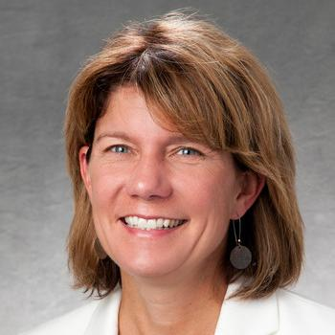
Group 3: Online Synchronous Discussion in Zoom
Representing the University Leadership perspective
Lisa Burke, Facilitator
Access Zoom meeting via handout instructions

Slide 50
Debrief on Discussion Experiences as a Group

Slide 51
Central Georgia Technical College
“blendflex”
University of St. Thomas
“hyflex”

Slide 52
Thank you!

