Slide 1
August 2, 2018
eLearning Summit
Scaling up a Successful Campus-based Initiative for a Large, Diverse State System
Karen Pikula, PhD, Central Lakes College/Educational Innovations, Minnesota State
Kimberly Johnson, PhD, Educational Innovations, Minnesota State

Slide 2
Today we will…
Share a successful OER faculty development effort – Campus System
Share processes, tools, what we’ve learned
Explore what this could look like in your context

Slide 3
Introductions
Introduce yourself to a colleague.
What do you do?
Why are you here, and what do you hope to learn?

Slide 4
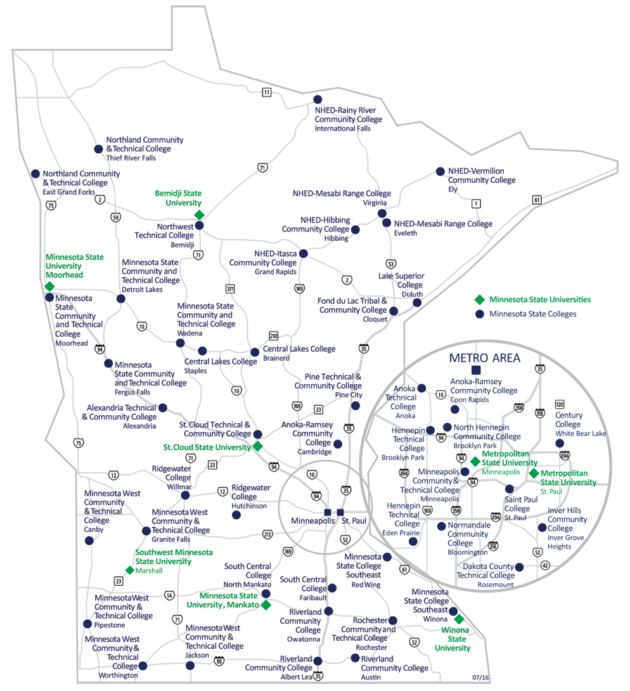
Introduction: Minnesota State
37 institutions on 54 campuses
Nearly 400,000 students
Approximately 9,000 teaching faculty

Slide 5
Introduction: instructional development
Successful instructor professional development follows these steps:
Teachers experience professional development.
The professional development increases teachers’ knowledge and skills, changes their attitudes and beliefs, or both.
Teachers use their new knowledge, skills, attitudes, and beliefs to improve the content of their instruction, their approach to pedagogy, or both.
The instructional changes that the teachers introduce to the classroom boost their students’ learning.
http://www.gcisd-k12.org/cms/lib/TX01000829/Centricity/Domain/78/A_Primer_on_Effective_Professional_Development.pdf

Slide 6
Introduction: What are Open Educational Resources?
Open Educational Resources are teaching, learning, and research resources that reside in the public domain or have been released under an intellectual property license that permits their free use and repurposing by others. OER include full courses, course materials, modules, textbooks, streaming videos, tests, software, and any other tools, materials, or techniques used to support access to knowledge.
https://www.hewlett.org/strategy/open-educational-resources/
Giulia Forsythe: www.flickr.com/photos/gforsythe/38088290601/

Slide 7
How about you?
Have you taught using OERs?
How much do you feel you know about OER?
How much do you know about Creative Commons licenses and copyright for open resources?

Slide 8
Why OER?
Affordability
students
faculty
institutions
system
legislators
https://farm8.static.flickr.com/7172/6555466069_3246e8b54e.jpg
Options and academic freedom
Increasing access and relevancy of content

Slide 9
https://s3.amazonaws.com/libapps/customers/1594/images/5Rs-Graphic400.jpg

Slide 10
Central Lakes College – OER Faculty Development
System office grant funding to increase faculty awareness and adoption of OER
Librarian and faculty-driven
OER Learning Circles as high-quality faculty development
Interactive support for faculty as they work through one of three pathways:
Reviewing a text
Redesigning a course
Authoring a text

Slide 11
Learning Circle Process
Access to mentor/Mentor knowledge
Time
Apply learning immediately
Collaboration with colleagues & experts
Appreciation and support from administration

Slide 12
OER Learning Circles: Central Lakes College
Faculty attend 80% of scheduled weekly meetings (face to face).
Faculty create, submit, and update weekly workplans and journals.
Faculty work in facilitated, cross-disciplinary, collaborative groups.
Faculty present their final work results to colleagues.
Three Pathways
OER Textbook Review
OER Course Redesign
OER Authoring
Participants are paid a stipend for their work…
OER textbook review between $200.00 - $500.00
OER Course redesign and OER authoring - $1500.00

Slide 13
Brightspace (D2L) Faculty Support Course Room
Structured weekly modules for each pathway
Repository of resources
Templates to guide/organize faculty work
Universal Design links
Quality Matters support and links
Case studies
Organizational structure for faculty work
Opportunity to share/discuss/ collaborate

Slide 14
Supports for participants
Support from facilitator and peers
Templates to guide work -
Individual Plan for OER Learning Circles
Textbook Resource Comparison Matrix
Subject Matter Experts available in response to needs
Universal Design
Copyright and CC licenses
Using Pressbooks for publishing

Slide 15
Your turn…
Are you familiar with a structure like the OER Learning Circles?
Would this be of interest to you or in your context?
What questions do you have?

Slide 16
OER Faculty Development
Minnesota State OER Vision:
Minnesota State wants to be the national leader in open education, ensuring accessible, affordable, and culturally relevant experiences for our students.
Minnesota State OER Professional Development Goals:
Introduce and expand awareness to open licensing, open textbooks, and open educational resources.
Encourage and support faculty to identify, use and/or author high-quality free or low-cost content for students.
Encourage and support faculty who seek to redesign courses or programs around free or low-cost content for students.
Build partnerships among faculty, students, librarians and others committed to reducing textbook costs for students.
OER Faculty Development Projects
Campus grants; OER Learning Circles
Librarian’s Workshop
Open Textbook Webinars
Koffee with Karen: OER Community Conversations

Slide 17
OER Faculty Development
Open Textbook Network workshops
Raising awareness, textbook review, textbook adoption
78% reviewed
33% adopted
What is next?
Adoptions, Redesigning courses, Authoring
Time
Compensation
Availability of ancillary materials
Administrator support

Slide 18
Scaling up the campus effort
Virtual meetings for 10-week OER Learning Circles
Braid this initiative with other system priorities
Encourage and support collaboration within and across institutions
Everything is CC-licensed and will be shared
Produce Pay it Forward guide for other faculty
OER Project Showcase at conclusion
Focus on faculty success
Demonstrate return on investment in faculty development

Slide 19
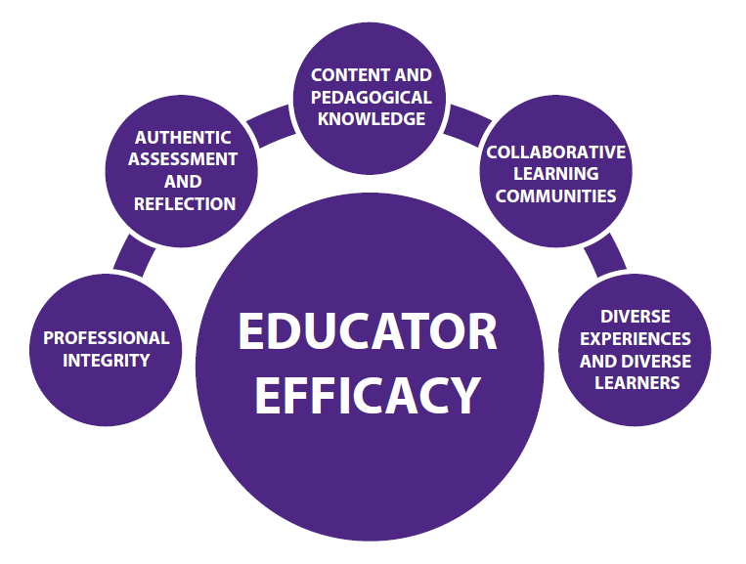
OER Learning Circles
Faculty supporting peers to:
Redesign courses around free or low-cost materials - Create a course shell or create a hard copy portfolio of content, objectives, and assessments for a course.
Develop ancillary materials to accompany existing open textbooks – Such as test banks, assignments, quizzes, videos, podcasts, PowerPoints.
Author open textbooks for developmental education or transfer pathways courses - Faculty from two or more different institutions.
https://a.google.com/search?q=collaborative+learning+circle&client=firefox-b-1-ab&tbm=isch&tbo=u&source=univ&sa=X&ved=0ahUKEwjSt_zujL3bAhVs3IMKHZJaD5QQsAQIOQ&biw=1280&bih=584#imgrc=5SO3leilG4GgkM:

Slide 20
OER Learning Circles: Across the System
Faculty attend 80% of scheduled Learning Circle meetings (online) over 10 weeks.
Faculty create, submit, and update weekly workplans and journals.
Faculty work in facilitated, cross-disciplinary, collaborative groups.
Faculty present their final work results to colleagues and system leaders.
Authoring Ancillary Materials
OER Course Redesign
OER Authoring
Participants are paid a stipend for their work…
1 credit release for OER Authoring of Ancillary Materials, OER Course Redesign
3 credit release for Authoring of OER textbooks

Slide 21
OER Learning Circles
2018 Faculty Development PROJECTS
Course Redesign
5 faculty
Authoring of Ancillary Materials
13 faculty
Authoring of Textbooks (for developmental education or transfer pathways)
3 Groups- 9 faculty
http://pndblog.typepad.com/.a/6a00e0099631d0883301bb09abd3eb970d-popup
27 faculty
17 colleges and universities

Slide 23
Faculty OER PRojects
Ancillary Materials
Test banks; multiple file formats for test banks
Lab manuals/ Lab activities for Chemistry / Biology
Assignment guidelines text to supplement textbook
PowerPoints, Study Guides, Quizzes
Activities/ Handouts/ Vocabulary lists/
Assessments
Narrated presentations
Portfolio of Intermediate Algebra resources
Student centered examples & diverse videos
Manual to assist teachers in managing collaborative transmedia storytelling projects
New textbooks
Building Academic Literacy
YOU: Writing! A First-Year Composition Textbook
Microbiology Textbook (6 Chapters)
Bonus: Course Redesign ends up a textbook!
Introduction to Philosophy: Words of Wisdom
Courses Redesigned
ADSC1031 - Business English Skills
MUS2201 & MUS2202 - Music Theory & Musicianship I & II
HLTH1150 – Wellness
Bonus: Course Redesign ends up as a Chemistry Lab Manual!

Slide 24
Superb Resources +
Collaboration:
Between universities and colleges
Between faculty in OER Learning Circles and faculty in departments across the state
Interdepartmental consulting on projects/peer review
Personal Professional Growth and Development
Journal Reflection
“This is crazy cool. I have learned so much. I have been able to start a few academic papers, plus pull from some old drafts I have, to work on a chapter on “Style”—I didn’t know this OER textbook project was going to help my career so much!”
http://pndblog.typepad.com/.a/6a00e0099631d0883301bb09abd3eb970d-popup

Slide 25
Affordability and more!
Faculty addressing accessibility, equity, diversity
https://www.google.com/search?client=firefox-b-1-ab&biw=1280&bih=584&tbm=isch&sa=1&ei=9b8WW7i1DavNjwTwsoSQCA&q=aha+moment&oq=aha+moment&gs_l=img.3..0l10.14988.24401.0.25401.21.16.0.0.0.0.325.1249.8j3j0j1.12.0....0...1c.1.64.img..9.4.641...0i67k1j0i8i30k1j0i24k1.0.v-AcLexhvGw#imgrc=kOn2Te4DasjjbM:

Slide 26
Examples:
Accessibility
Text with style headings and Alt Tags for images and sans-serif font for more web readability.
Close-captioning all videos.
Accessible and mobile-friendly content for students who used their phones.
Diverse perspectives
Inclusion of modern materials (TedTalks and speeches) of living philosophers who are female or indigenous or not from a western context.
Replacing business case studies with local examples that reflect the changing demographics of workers in the Midwest.
Changing research examples used to reflect the diversity and interests of the students in class, such as replacing a case study about fracking to a case study about hijab bans in Europe.

Slide 27
Examples:
Relevant and student-generated content
Names changed to better reflect the students– changing Kathy or Dan to names such as Koua, Faiza, Dao, Mohamed.
Student-collected “sample speeches" from local communities that become course materials.
Students find and collect "culture in my backyard" video stories for use in the course.
http://wiki.sugarlabs.org/images/thumb/1/1b/Oer-rmx.svg/850px-Oer-rmx.svg.png

Slide 28
Your turn…
Imagine that you are going to design an OER Learning Circle in your context. What assets do you have to make this happen? What challenges do you anticipate?
Share your thoughts with others.

Slide 29
Questions?
https://upload.wikimedia.org/wikipedia/commons/7/7a/Crowd-Ideas-300x199.jpg

