Slide 1
Beyond Textbooks and Coursepacks: Using the LMS to Make Course Materials More Affordable

Slide 2
Greg Argo Associate Director Access & Digital Services University Libraries Trent Brager Education and Social Sciences Librarian Glori Hinck Instructional Designer, STELAR

Slide 3
Fixing the Broken Textbook Market
$1,200 average expenditure per year on textbooks and course packs
65% decided against buying a textbook or coursepack because it was too expensive
82% felt they would do significantly better in a course if the textbook/coursepack was available free online
Fixing the Broken Textbook Market Released 2014 by: U.S. Public Interest Research Group: http://www.uspirg.org/reports/usp/fixing-broken-textbook-market
Notes:
The average student spends $1,200 per year on textbooks/coursepacks.
65% of students said that they had decided against buying a textbook/coursepack because it was too expensive.
82% of students felt they would do significantly better in a course if the textbook/coursepack was available free online and buying a hard copy was optional.

Slide 4
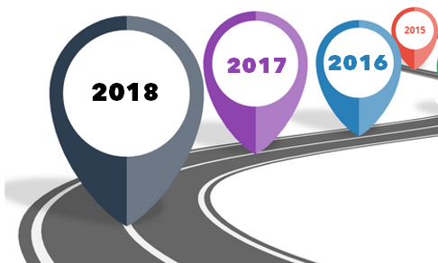
Fixing the Broken Textbook Market Timeline & Roadmap
Notes:
This presentation will talk about one approach to fixing this broken textbook market.

Slide 5
Timeline & Roadmap 2016
Creation of a new faculty support unit within the library
Notes:
In 2016 a new faculty support unit called STELAR- St. Thomas eLearning and Research was created within the Library

Slide 6
Timeline & Roadmap 2017
Migration to the Canvas LMS
Notes:
Migration to Canvas LMS
Glori 1-6

Slide 7
Timeline & Roadmap
Migration to Ex Libris’s Alma library system
Notes:
Migration to Ex Libris’s Alma library system
Greg 7-18

Slide 8
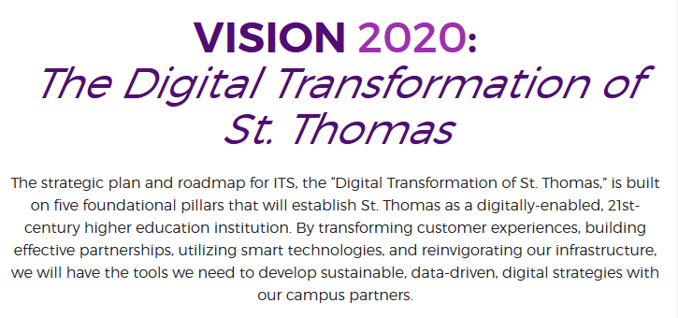
Timeline & Roadmap
ITS Strategic Plan: Embrace Digital Transformation

Slide 9
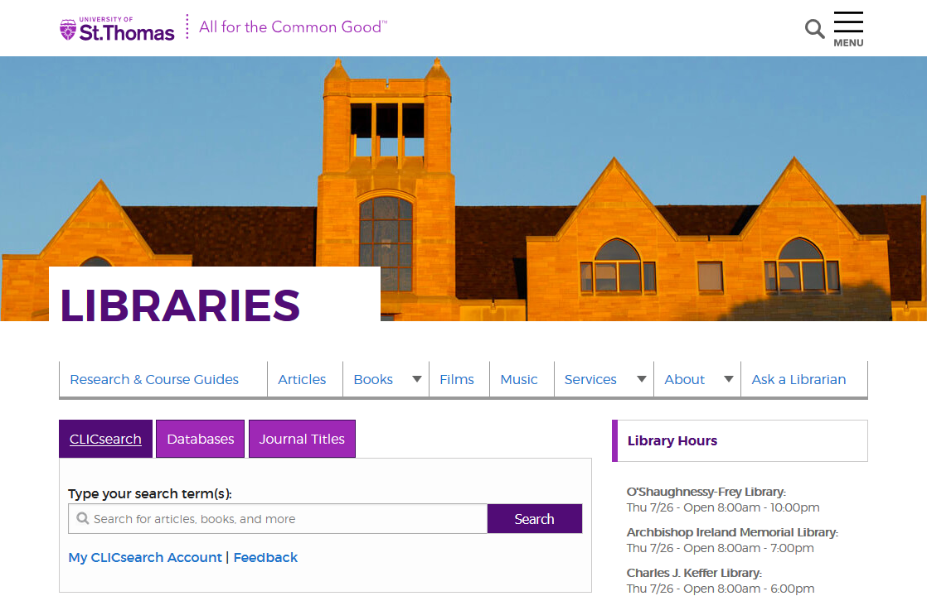
Timeline & Roadmap
Libraries Strategic Plan: “Provide course materials in the most appropriate format to faculty and students on a course by course basis.”

Slide 10
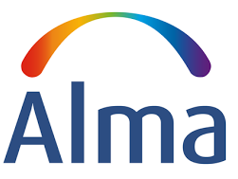
Timeline & Roadmap
Pilot 2017
Leganto application available
Integration with Alma and Canvas

Slide 11
Putting the pieces together
Anticipated benefits….
Notes:
We are now putting the pieces together to reap the benefits

Slide 12
Affordability
Image: USA Today College
Positive Impact on Student Learning

Slide 13
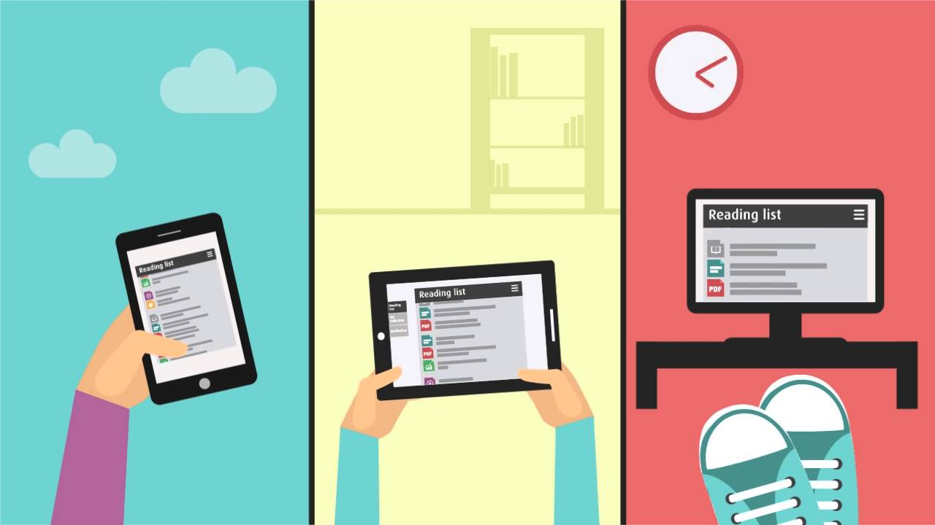
Ease of Access
Delivery to device of choice through Canvas

Slide 14
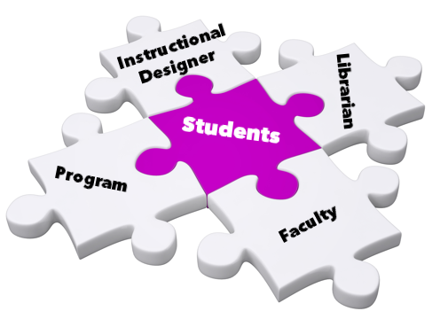
Course Development Collaborations

Slide 15
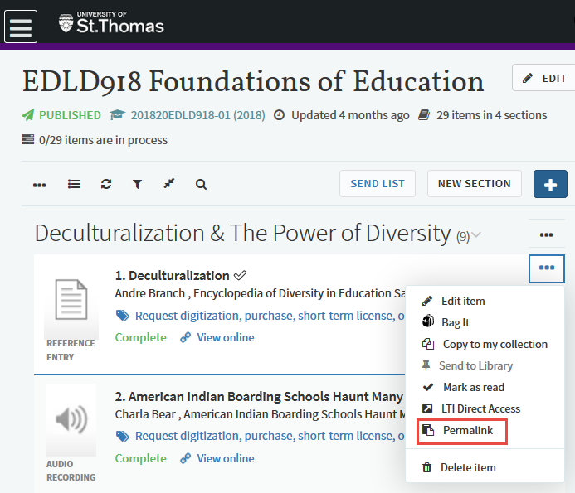
Technical Ease of Delivery
Permalinks can be generated for items or sections for sharing or embedding in LMS modules

Slide 16
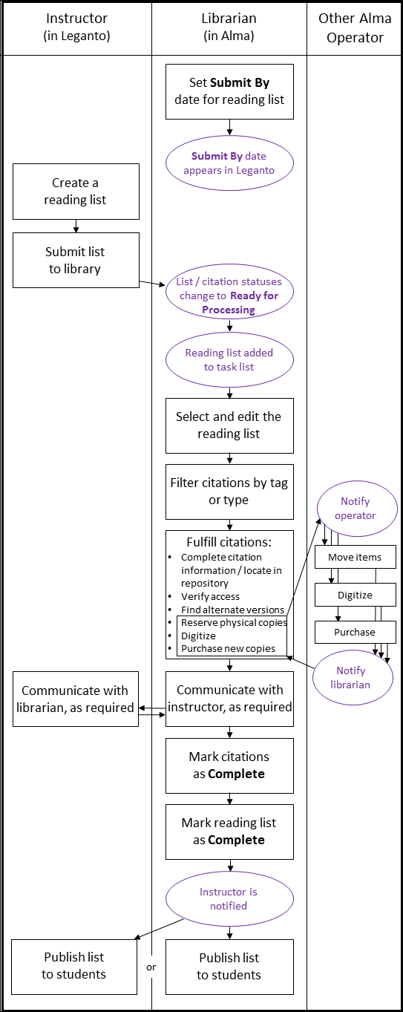
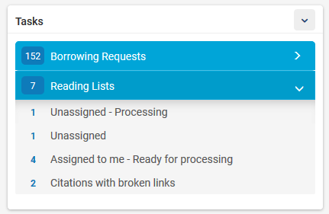
Streamlined workflows
Coding
Creating new lists
Communications
Material “Visibility”
Notifications:

Slide 17
Student Engagement Metrics

Slide 18
Increased ROI on Library Resources
Notes:
N

Slide 19
The collaborative process New and Improved! Faculty Librarian Instructional Designer
Notes:
Glori 19-29
The adoption of these technologies has facilited the creation of a new and improved collaborative process between faculty, librarians, and ID’s around providing content for student courses.

Slide 20
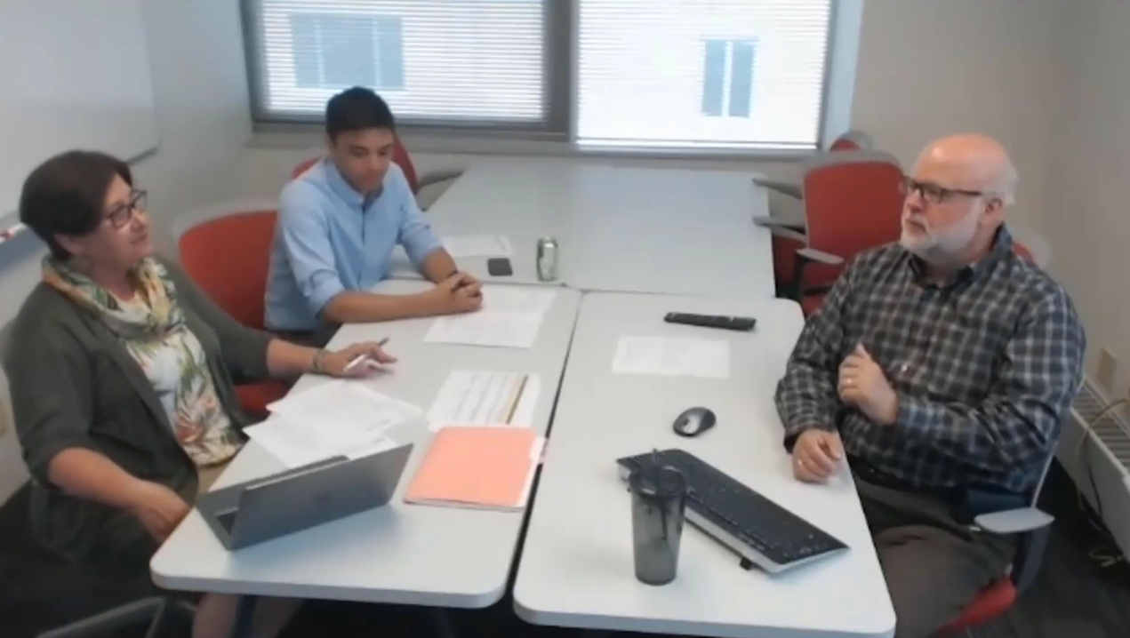
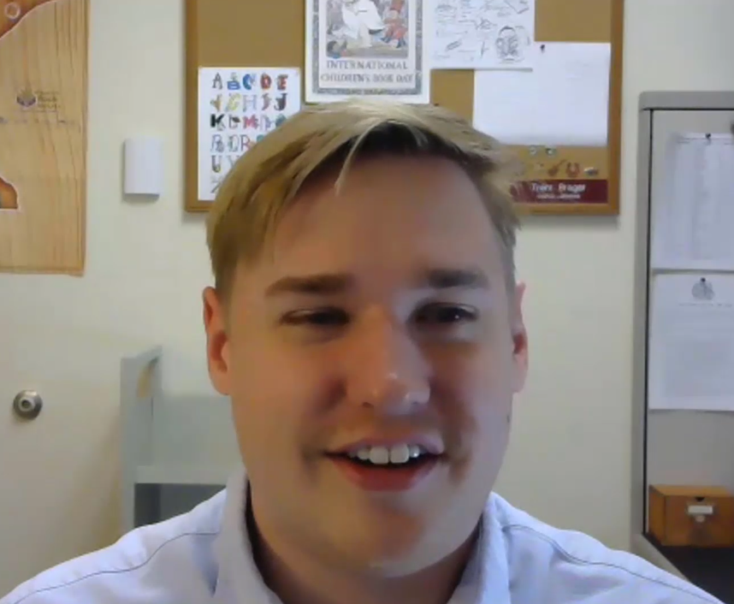
Notes:
https://www.screencast.com/t/U4gxOtIz

Slide 21
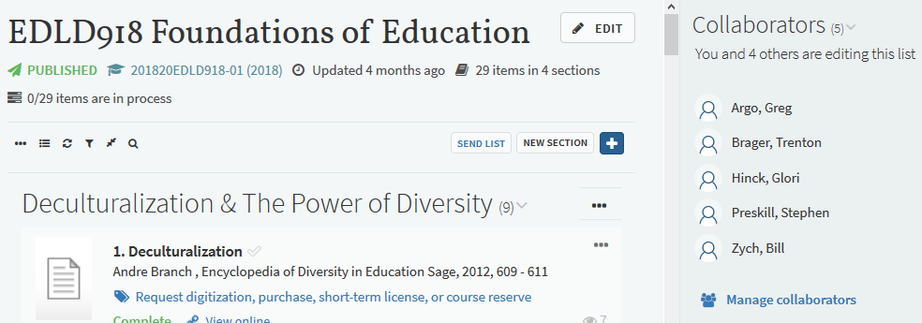
Collaborators
Program Manager
Subject Librarian
Instructional Designer
Instructor
Course Reserves Operator
Notes:
This slides illustrates the collaborative process and the stakeholder involvement

Slide 22
Instructional Designers Perspective

Slide 23
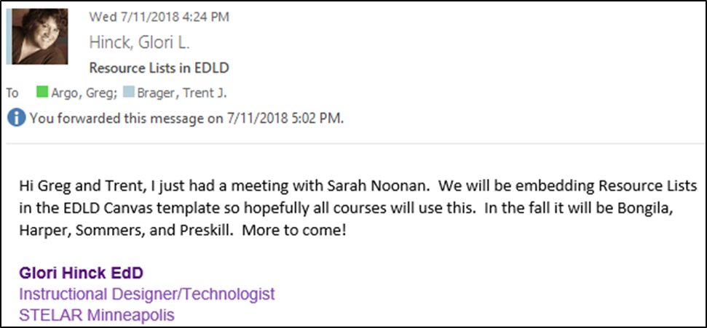
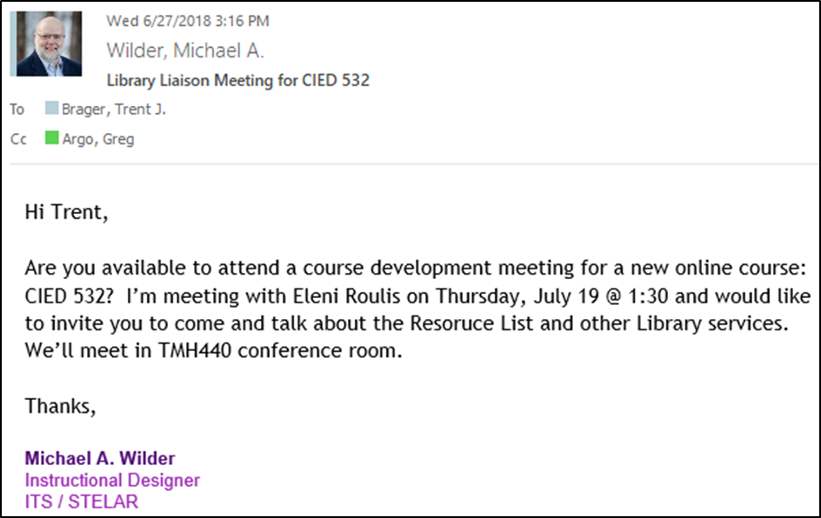
Instructional Designer/ Librarian Collaboration
Notes:
I am working much more closely with the librarians now in the course design process.

Slide 24
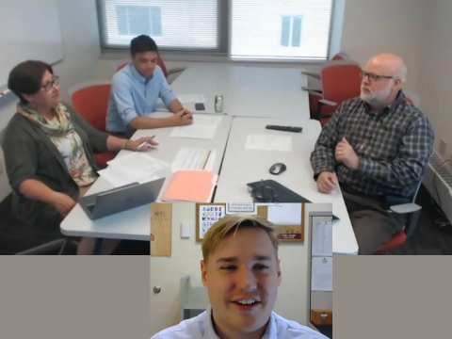
Begins a Faculty/Librarian Conversation

Slide 25
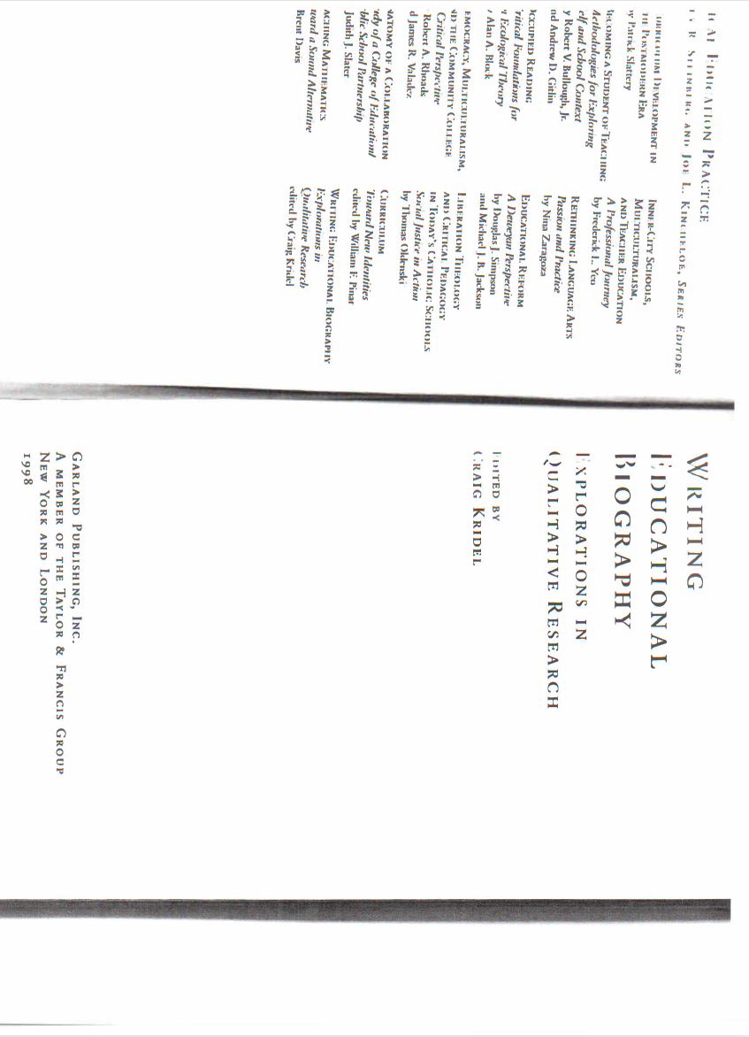
Supports Copyright Compliance/Resource Quality
Notes:
Glori and Greg

Slide 26
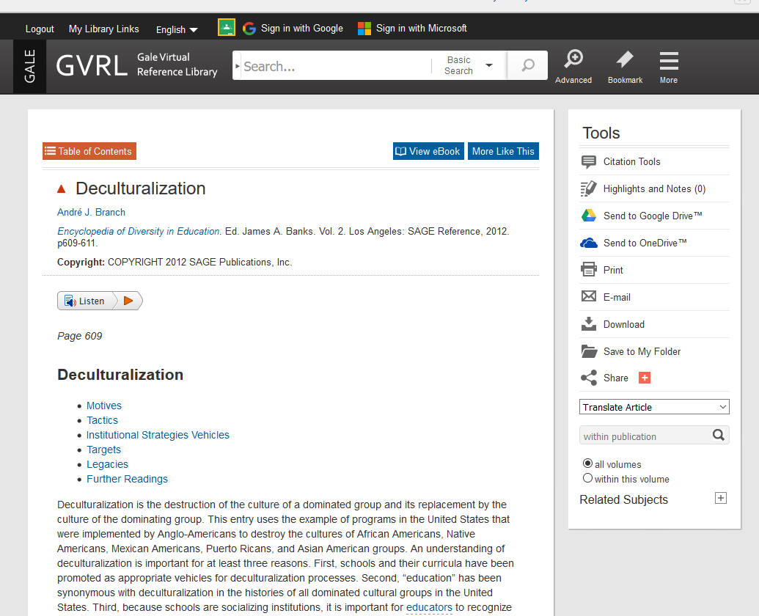
Facilitates Access & Decreases Costs for Students

Slide 27
Faculty Testimonial
This is so awesome I can barely stand it! Thanks so much! It looks great and what a great service that you provide with this. It’ll be so helpful down the line, and to know of this capability will enable me to do 90% of this on my own with my two fall classes!
Christoper Vye
Graduate School of Professional Psychology

Slide 28
What students are saying:
I could go back and forth from Canvas and the resource list, it was easily accessible. I also liked how the articles had multiple links and the "broken link" button.
I liked the organization structure; it was easy to find the articles we needed to read.
I think students would enjoy using this for their own purposes such as projects and essays.

Slide 29
What students are saying:
Promoting this in other classes can benefit students greatly I think. Not enough students, including myself use the library sources anymore.
Really great software that I think you should use for all classes in the future.
Could leave it up to the students to locate useful articles like these instead of simply presenting it to us.

Slide 30
Spring 2018 Pilot Results
15 faculty
19 courses
10 programs
289 students
579 total citations
Students in the pilot saved $22,260 in total, or an average of $77 per student per course
Notes:
$3 each
Greg 30-33

Slide 31
Summer Growth in Adoption
23 faculty (+8)
24 courses (+5)
12 programs (+2)
No repeat faculty or courses from the Spring pilot!

Slide 32
Challenges Ahead
Training
Consistent Copyright Practices
Identifying correct partners
Scaling
Notes:
Identifying correct partners (IDs/liaisons/managers/Course Reserves operators)

Slide 33
Discussion Usefulness for your institution?

