Slide 1
An Approach to Instructional Design Capacity
Joel Johnson
Nathan Lentfer, PhD
University of Northwestern-St. Paul

Slide 2
Introductions
Joel Johnson, MA Director of Academic Technology and Online Learning
Nathan Lentfer, PhD Instructional Designer & Technologist Manager Online Learning Office

Slide 3
What we will be addressing today?
Context
Four Foundational Principles
Benefits
Lessons Learned
Questions
Notes:
Nathan

Slide 4
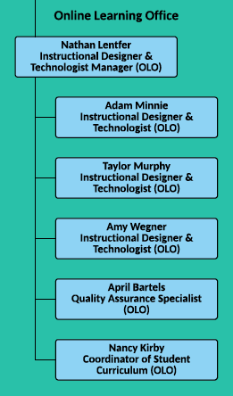
Context
Online Learning Office (OLO, Created in February 2015)
Part of our QIP Initiative for HLC
Merging of two Instructional Design teams
Issues being addressed as we came together
Two teams coming together
Asked to do more than we could handle
Needed to forecast development
Main responsibilities today
30+ active CD projects/month
Maintaining 260+ courses across 360+ sections
Online and blended program and course
Training and support approx. 200 faculty
Open textbook adoption
Notes:
Joel

Slide 5
Foundational Principle 1: Look at where your time is spent.
Where is time going?
Descriptive at this point not prescriptive
Acknowledge reality
Consider it all - beyond course development
Different roles have different responsibilities and time distribution
How this worked for us:
3-hour group meeting
Looking at our actual schedules (meetings, development, maintenance, etc.)
Dialogue on understanding reality
Notes:
Joel

Slide 6
Foundational Principle 2: Look at the types of projects you have.
How much Instructional Design time does it take for each of these?
New Courses
Revisions (Full vs Light)
Special Projects
Additional Operations and Support
How this worked for us:
No previous time records on projects beyond start and end dates
Mostly gut reaction and intuition at first
Considered how much time we were spending by level and credit hour.
Notes:
Joel

Slide 7
Foundational Principle 3: Determine a baseline for your projects.
What is the most basic unit of Instructional Design time that you have for developments?
It could be multiplied for larger developments.
It could be halved for small developments.
It is a tool for measure rather than a scientific certainty.
It would likely be different for every design team.
How this worked for us:
We decided on the idea of “tokens.”
For us, 1 token = a 1-credit revision = 12 hours of ID design time
Notes:
Nathan

Slide 8
Foundational Principle 4: Develop a framework.
How much time do you have for projects in a semester, in a year?
Take the percentage of time you set aside for development and calculate the number of tokens in a semester/year.
Figure out how many new courses or revisions you can do in a semester/year.
Does that sound right?
Bring this information to your development discussions.
How this worked for us:
Our projects are designed to take a semester
Allow for some buffer
Capacity Calculator
Notes:
Nathan

Slide 9
Benefits
Protects the team and individuals from over-allocation
Helps team complete projects in expected time frame
Gives team members a clear view of expectations
Gives administration a measure of what our team can do
Allows administration to forecast effectively and better resource allocation
When unexpected requests are made, we can give a better supported response
We can forecast hiring needs
We can more accurately describe the work that new hires should expect
Notes:
Nathan

Slide 10
Lessons Learned
Don’t be too rigid as you start.
Allow for a growing understanding of what is going on in your team.
Evaluate and learn as you keep going.
Be willing to revisit initial assumptions and estimates.
Need to develop a consistent course flow.
Communicating to administration about your framework will take time.
Getting the team into a consistent time tracking setup helps a lot.
Notes:
Joel

Slide 11
Questions?
Joel Johnson, MA Director of Academic Technology and Online Learning
jtjohnson@unwsp.edu
Nathan Lentfer, PhD Instructional Designer & Technologist Manager Online Learning Office
nvlentfer@unwsp.edu

